Slide 1
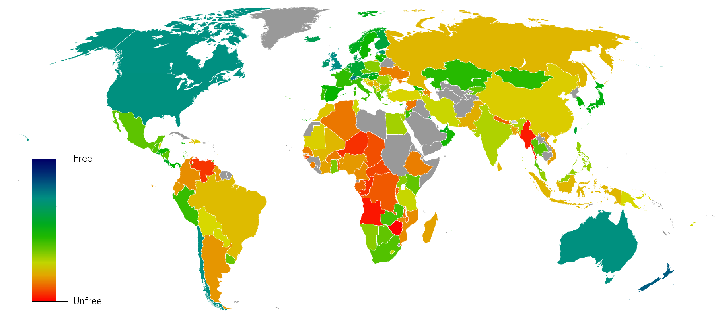
Charting a Path to Prosperity: The Economic Freedom of the World Map in the Classroom
The Fraser Institute, November 1, 2013 Charity-Joy Acchiardo & G. Dirk Mateer
Notes:
Economic freedom on one foot

Slide 2
Support for this project was provided by the
Center for the Study of Capitalism and the Economy
Persons interested in learning more should visit:
http://www.freetheworld.com/

Slide 3
About this resource:
These PowerPoint slides are designed for instructors interested in teaching about economic freedom. You are welcome to use any portion of this work for this purpose.

Slide 4
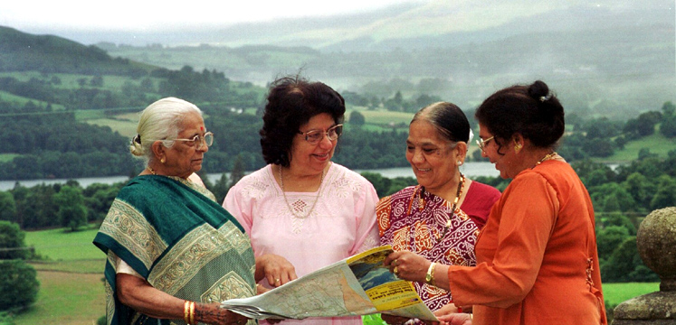
Lesson 1
Reading a Map:
The World Economy
Notes:
Students should consider the correlation between economic freedom and prosperity by studying the information contained on the Economic Freedom Map.

Slide 5
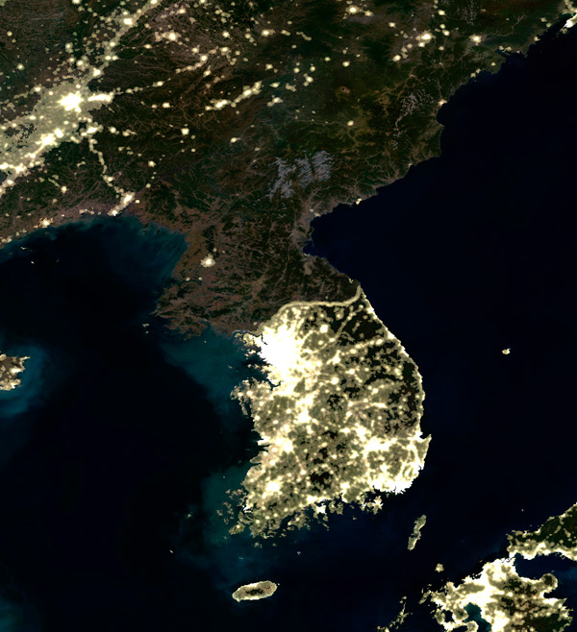
Economic freedom and performance
varies dramatically among nations.
Notes:
The absence of lights in North Korea indicates a lack of economic freedom compared to South Korea.

Slide 6
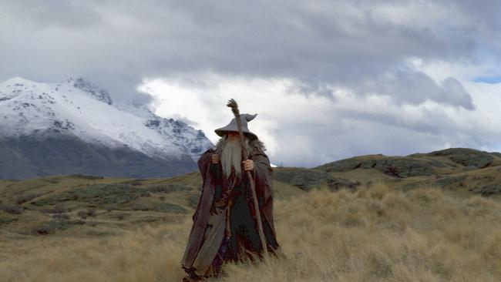
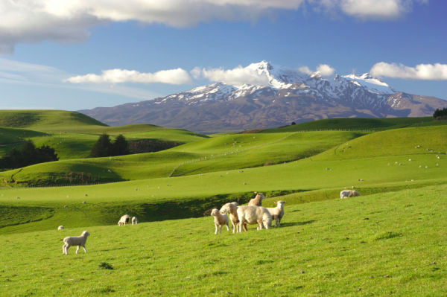
Guess the Country!
Region: South Pacific
Population: 4,242,048
Country:_________
GDP Per capita
(PPP)=___________
Notes:
GDP per capita = 32,219

Slide 7
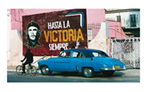
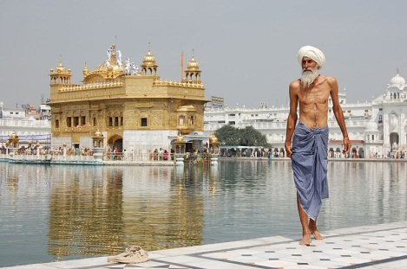
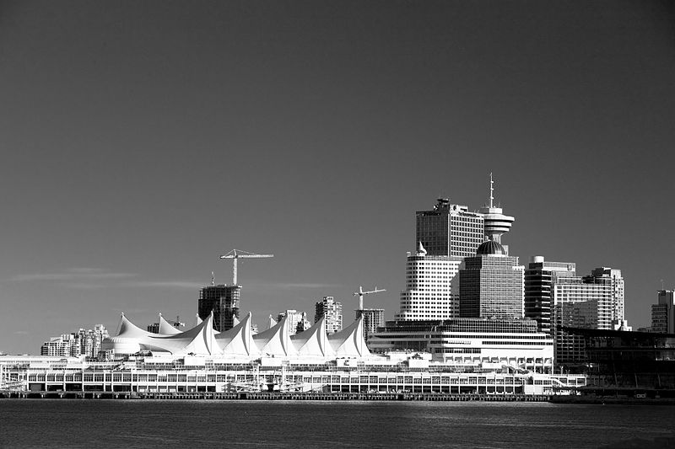
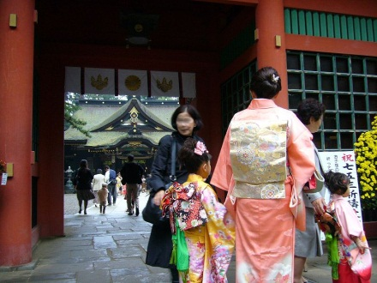
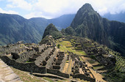
Economic Behaviour Around the World
Region: Caribbean
Population: 11,075,244
Country:_________
GDP Per capita
(PPP)=___________
Region: Asia
Population: 1,205,073,612 Country:_________
GDP Per capita
(PPP)=___________
Region: North America
Population: 34,300,083 Country:_________
GDP Per capita
(PPP)=___________
Region: Asia
Population: 127,368,088 Country:_________
GDP Per capita
(PPP)=___________
Region: South America
Population: 29,549,517 Country:_________
GDP Per capita
(PPP)=___________
Region: Africa
Population: 12,619,600 Country:_________
GDP Per capita
(PPP)=___________
Notes:
Show the Economic Freedom of the World Map but hide the title so that students don’t know what it is representing.
Look at the pictures in the handout
and guess which country is shown
Guess the GDP per capita in that country
Now, form small groups. Come to a consensus on the country name and order the countries from wealthiest to poorest. (Students may already be aware of the relative differences). Students should be aware of their preconceptions.
Compare your guesses with the
information in the handout and map
What is the color of each country on the map?
What do you think the map represents?
What do you think is the title?

Slide 8
Economic Behaviour Around the World
Region: Caribbean
Population: 11,075,244
Country: Cuba
GDP Per capita
(PPP)= US$9,900
Region: Asia
Population: 1,205,073,612 Country: India
GDP Per capita
(PPP)= US$3,500
Region: North America
Population: 34,300,083
Country: Canada
GDP Per capita
(PPP)= US$39,400
Region: Asia
Population: 127,368,088 Country: Japan
GDP Per capita
(PPP)= US$34,000
Region: South America
Population: 29,549,517
Country: Peru
GDP Per capita
(PPP)= US$9200
Region: Africa
Population: 12,619,600
Country: Zimbabwe
GDP Per capita
(PPP)= US$500
Notes:
The map illustrates the level of economic freedom in most countries in the world.
The map does not intend to demonstrate the level of economic growth, levels of wealth, political freedom or literacy in countries around the world.
The map does demonstrate a correlation between economic freedom and other conditions like economic growth, levels of wealth, citizen literacy and political freedom.
The measurement of economic freedom raises the question about causation between economic freedom and other desirable outcomes such as economic growth, levels of wealth, political freedom and citizen literacy.
All knowledge is conditional. It is based on the best evidence we have to this point. As new evidence surfaces, we must adjust our knowledge to include the new evidence to better explain the realities around us. That is the purpose of gaining economic knowledge---to help people choose to use scarce resources more wisely to improve human living standards.

Slide 9
Economic freedom means people are free to:
Trade with others
Compete in markets
Buy what they want
Keep what they earn
Own things privately
Earn a living in a job they choose
Notes:
http://vimeo.com/73401865
5 min

Slide 10
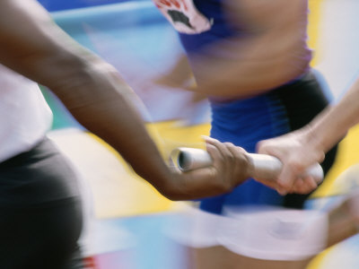
Lesson 2
Map Reading Relay Race
Notes:
The Economic Freedom of the World Map visually displays complex relationships within the EFW Index.

Slide 11
The EFW index measures the degree of
economic freedom in five major areas:
Size of Government (expenditures, taxes, enterprises)
Protection of property rights
Access to sound money
Freedom to trade internationally
Regulation of credit, labour, & business
Notes:
The Economic Freedom of the World Map visually displays complex relationships within the EFW Index.

Slide 12
The Rules
Choose a captain & recorder
Send only 1 teammate at a time
Answer questions in order, 1 at a time
All team members must take their turn
The team may discuss answers
Record time - add one minute for
unanswered or incorrect answers
The team with the lowest score wins!
Notes:
Distribute Handout 2-1

Slide 13
Map Reading Relay Race
1. What is the title of the map?
2. Per the map, what does “economic freedom” mean?
3. What colour indicates that a nation is “mostly free?”
4. What colour indicates that a nation is “relatively free?”
5. What colours indicate that a nation is “relatively unfree?”
6. What colour indicates that a nation is “mostly unfree?”
Notes:
1. Economic Freedom of the World
2. Economic freedom means that people are free to trade
with others, compete in markets, buy what they want,
earn a living in a job they choose, keep what they earn,
and own things privately.
3. Blue 4. Green 5. Yellow and orange 6. Red

Slide 14
Map Reading Relay Race
7. Which are more economically free:
dark-blue nations or light-blue nations?
8. What colour indicates that economic
freedom in a nation is “unmeasured?”
9. Are “unmeasured” countries more likely to be mostly
or relatively free or mostly or relatively unfree?”
10. Is Canada more or less economically
free than the United States?
11. How many countries are more
economically free than Canada?
Notes:
7. Light-blue
8. Grey
9. They are more likely to be mostly or relatively unfree. The fact that they are unmeasured means their governments refused to provide the data or did not keep accurate data. Economically unfree nations are not as open as economically free nations
10. Canada’s economic freedom rating is 7.81 (7.93). The U.S. is 7.60 (7.73).
Canada is ranked 6th in 09 (8th in 2011); the U.S .is ranked 10th in 09 (17th in 2011).
11. Five countries have more economic freedom than Canada.

Slide 15
Map Reading Relay Race
12. Which country is more economically free, Mexico or Chile?
13. Which country is more economically free, India or China?
14. Which continent has the greatest
number of “mostly free” countries?
15. Which continent has the greatest
number of “mostly unfree” countries?
16. In which type of country do people live the longest?
17. Which type of country has the highest income per person?
Notes:
12. Chile
13. China (they switched in 2011!!)
14. Europe (with about 18 “mostly free” countries – 17 in 2011).
15. Africa (with about 19 “mostly unfree” countries plus several “unmeasured” countries which means they are more likely to be unfree – 25 in the 2011 index!).
16. “Mostly free” countries: 79.4 years compared to 60.7 years in ‘mostly unfree’ countries.
17. ‘Mostly free’ countries: Annual per capita GDP of US$31,501 compared to US$4,545 in ‘mostly unfree’ countries.”

Slide 16
Map Reading Relay Race
18. In which type of country does income
per person grow by the highest annual rate?
19. In which type of country are political rights & civil
liberties most protected? (Hint: read the scale carefully)
20. What is the purpose of the
Economic Freedom of the World Map?
Notes:
18. “Mostly free” countries: For the period from 1990 to 2009, the annual growth rate in per capita GDP was 3.07 percent compared to 1.18 in ‘mostly unfree’ countries.”
19. “Mostly free” countries (In this graph the lower number is the better number).
20. The map indicates the degree to which economic freedom is present in different countries. At a glance, a person can see how economically free a country is compared to other countries.

Slide 17
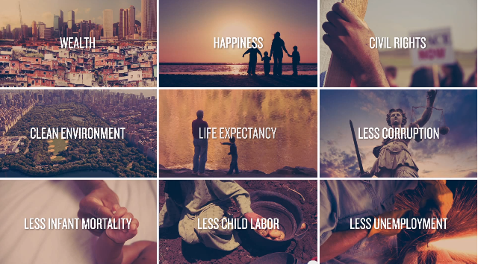
Nations that are economically free outperform
nations that are not economically free
Notes:
The index is important because it clearly shows how nations can improve the well-being of their citizens. Nations that are economically free outperform nations that are not economically free in such indicators of economic well-being as average income per person, average economic growth rate per person and life expectancy. The index and map make it clear what a nation’s level of economic freedom is and which policies a nation should follow to improve the lives of its citizens. The average economic freedom score rose from 5.53 (out of 10) to 6.74 in 2007, but fell back to 6.67 in 2008 and to 6.64 in 2009. The 2011 Annual Report uses data from 2009

Slide 18
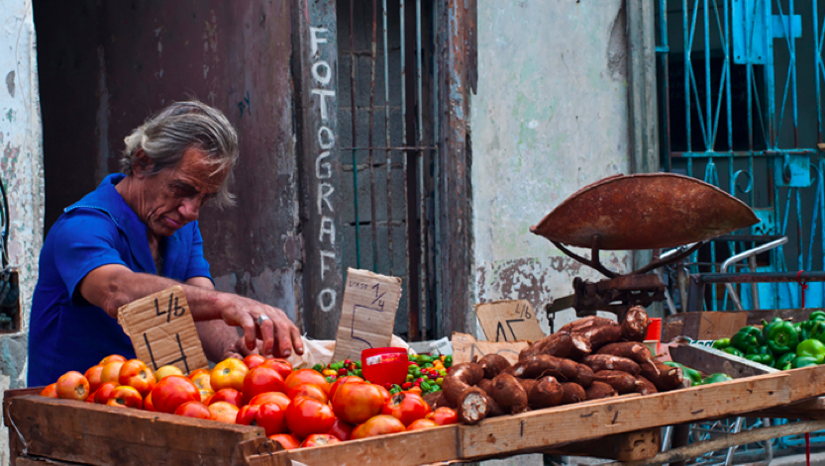
Lesson 3
What is economic freedom
and why do we care?
Notes:
Economic freedom creates wealth and improves standard of living, not the other way around.

Slide 19
Economic freedom means people are free to:
Trade with others
Compete in markets
Buy what they want
Keep what they earn
Own things privately
Earn a living in a job they choose
Notes:
Define Economic Freedom
Illustrate the correlation between
economic freedom and prosperity

Slide 20
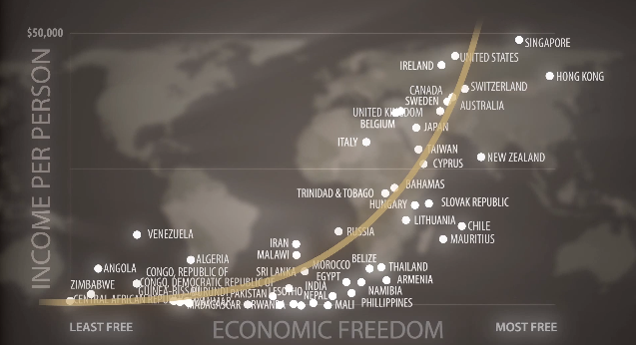
Economic Freedom and Quality of Life
Notes:
http://www.youtube.com/watch?v=v1U1Jzdghjk Stop at 1:53

Slide 21
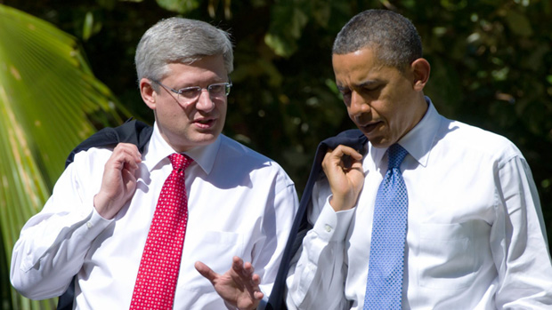
Size of Government
(expenditures, taxes, & enterprises)
Notes:
Read Handout 3.1
http://www.cato.org/policy-report/mayjune-2012/we-can-cut-government-canada-did
Government Spending
Government spending at all levels (federal, state/provincial and local) has traditionally been higher in Canada than the United States. In Canada, government spending as a percentage of GDP peaked at 53% in 1992. Since 1992 spending has steadily declined in Canada to just below 40 percent in 2008.^{[8]}
Spending in the United States fluctuated narrowly around 34-38 percent of GDP over the same period.^{[9]} However, starting in 2008 US spending has turned sharply upwards to reach an estimated 42.7% of GDP in 2009^{[dated info]} ^{[10]} from 39% in 2008. Spending is expected to reach 45% of GDP in 2011^{[dated info]},^{[11]} and stabilize at that level.

Slide 22
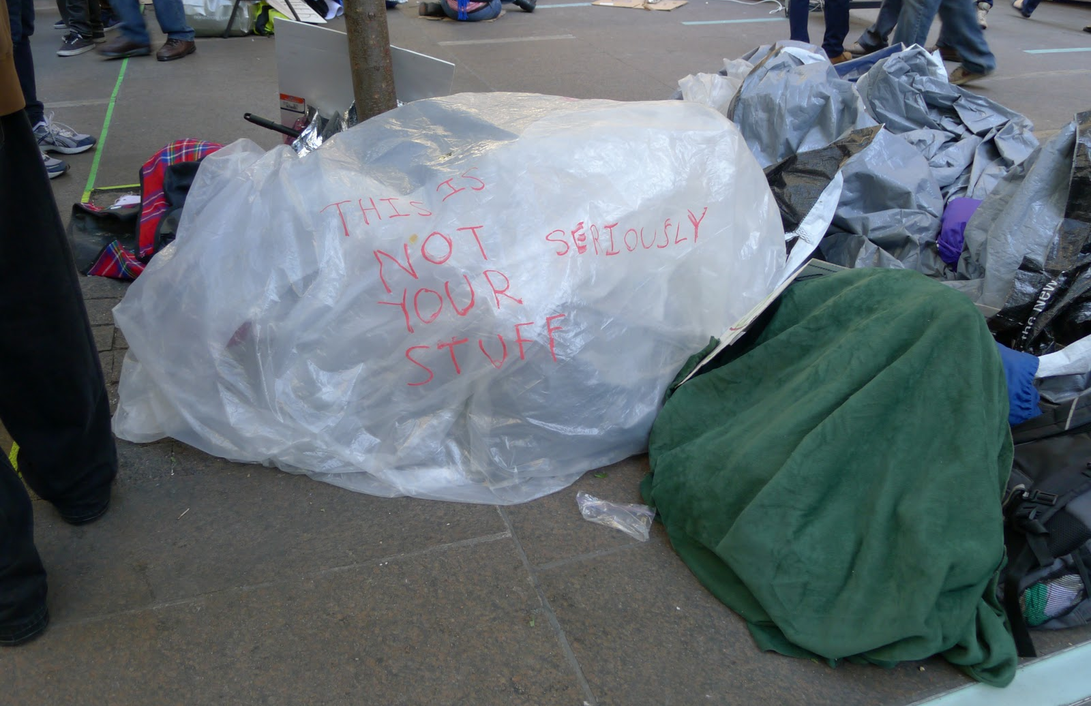
Protection of property rights
Notes:
http://www.youtube.com/watch?v=wYnrUkKR1lo Cue to 1:20

Slide 23
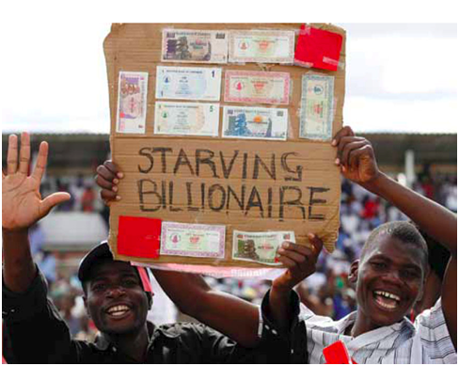
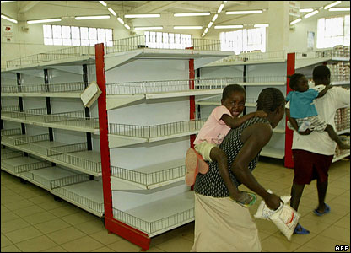
Access to Sound Money
Notes:
How might your consumer behaviour change in an environment of hyper-inflation?
How would credit/loans change?

Slide 24
Which country is this? (Text GUESS and your choice to 37607)
Has no agriculture of its own
Imports water
Has one of the world’s
lowest unemployment rates
Has one of the densest
populations on the planet
Is located in the tropics
Has no natural resources
Occupies 710 square km
Has four official languages
Has a literacy rate of 96%
Has a $35,500 per capita GDP
Notes:
Singapore
Singapore attained a total score of 8.72 (2011), placing it second, just behind Hong Kong. As will become evident among the top countries and was also noted in Hong Kong, Singapore stands out from the rest of the world for its strong property rights and fighting against corruption. The study also cited Singapore's efficient government, which keeps costs low as well as low taxes for the companies residing inside its borders. The country encourages open trade and also ranks highly in terms of offering investment and financial freedom. The government is highly involved in "guiding economic development," which could be considered excessive regulation but appears to only encourage a free market economy at this point in time. http://www.investopedia.com/financial-edge/1212/the-5-most-economically-free-countries-in-the-world.aspx

Slide 25
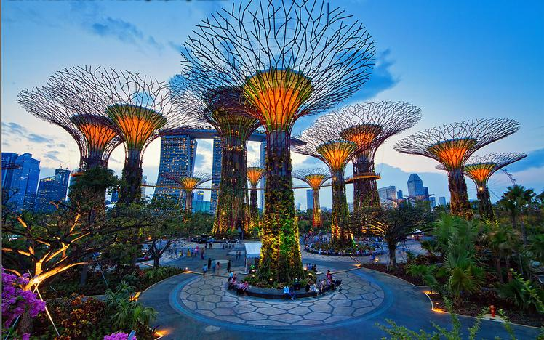
Freedom to Trade Internationally
Notes:
Simple trading game?
Picture of Singapore
Additional resource:
http://www.learnliberty.org/content/free-trade-v-protectionism

Slide 26
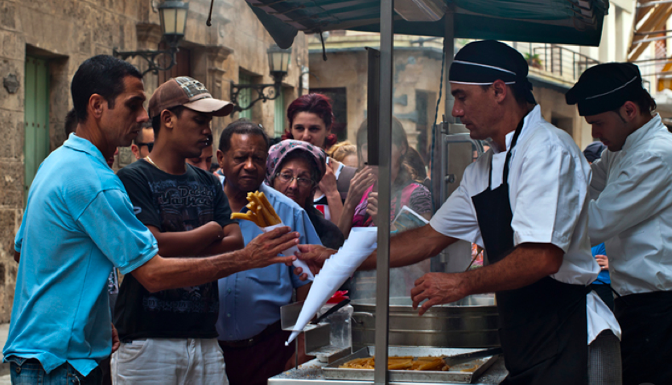
Regulation of Credit,
Labour, and Business
Notes:
Cuba
Cuba made it easier to start small businesses in 2011 – this has led to a surge in entrepreneurship in the predominately Socialist country.
http://iwpr.net/report-news/cuba%E2%80%99s-entrepreneurs-flourish-against-odds
http://www.theguardian.com/travel/2012/dec/07/cuba-entrepreneurs-spas-drag-nights
http://www.cubaabsolutely.com/AboutCuba/article_economic.php?id=Cuban-Entrepreneurs-From-Necessary-Evil-to-Strategic-Necessity

Slide 27
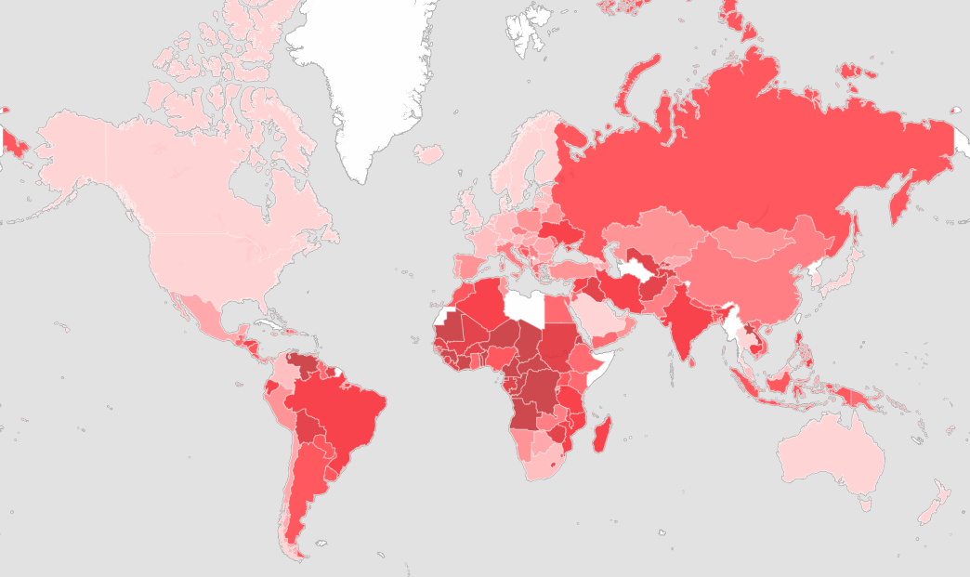
Ease of Doing Business Index
Notes:
http://data.worldbank.org/indicator/IC.BUS.EASE.XQ/
Starting a Business
Dealing with Construction Permits
Getting Electricity
Registering Property
Getting Credit
Protecting Investors
Paying Taxes
Trading Across Borders
Enforcing Contracts
Resolving Insolvency

Slide 28
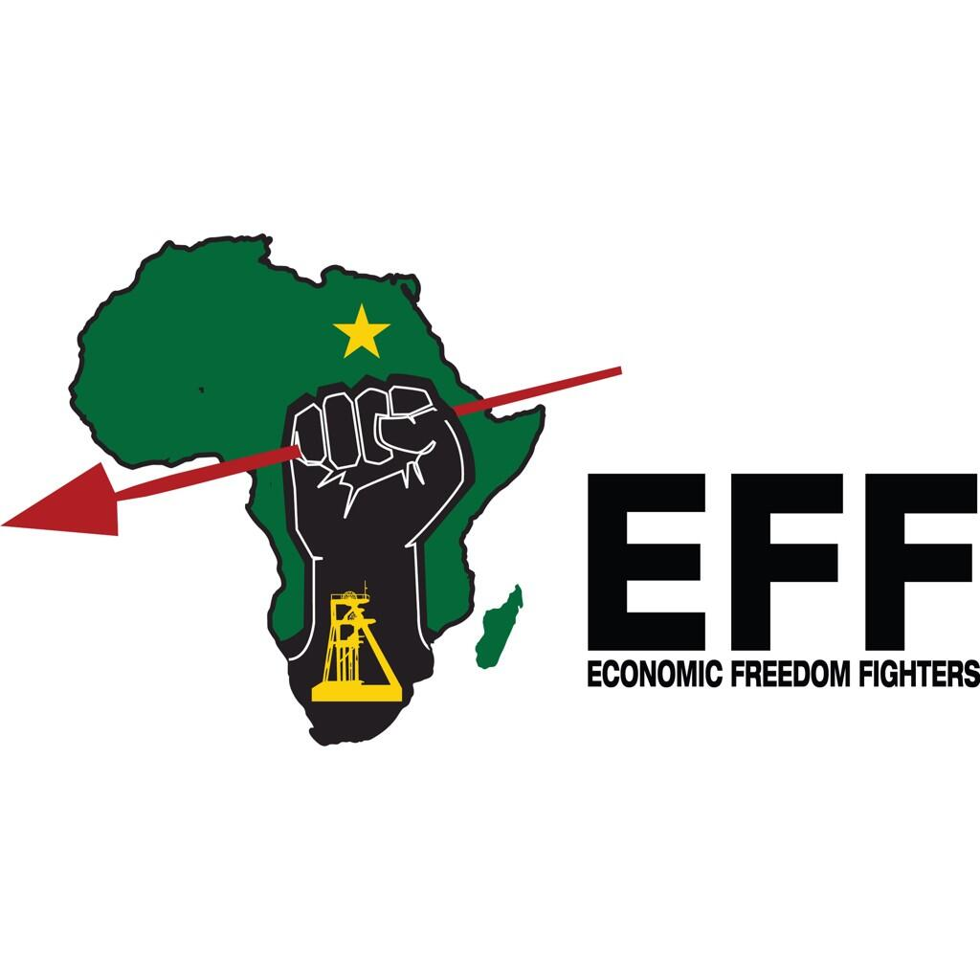
Notes:
History on the EFF
Timely change to the game!

Slide 29
The Economic Freedom Cup
Are the following statements true or false?
True: Cheer False: Boo
Notes:
For this in-class activity, read each situation out loud, and then have the students cheer or boo on your command.

Slide 30
The Economic Freedom Cup
The more the law protects private
property, the more economic freedom
the country’s citizens have.
True!
Notes:
Add true/false directions
(Governments that promote economic freedom have laws that even-handedly enforce contracts and protect individuals and their property from people who might use violence, force, or coercion to take what does not belong to them.)

Slide 31
The Economic Freedom Cup
People have more economic freedom when
the government determines how a nation’s
resources are used instead of relying on the
choices of private consumers and investors.
False!
Notes:
(When governments use force to allocate resources, economic freedom is reduced. Countries that rely more on markets, prices and voluntary exchange increase personal choices and allow people the freedom to buy and sell goods and services based on mutual benefit. In nations with high economic freedom, people can buy what they want, earn a living in the job they choose, and keep what they earn in that job.)

Slide 32
The Economic Freedom Cup
Economic freedom is increased
when the government taxes
rich people to help poor people.
False!
Notes:
(When taxes and government spending are increased, political choice replaces private choice. Higher taxes limit people’s ability to spend their income as they please. By taking income from some people and giving it to others, governments use force rather than choice. This decreases economic freedom.)

Slide 33
The Economic Freedom Cup
People have more economic freedom if the
government prevents consumers, businesses
and investors from making poor decisions.
False!
Notes:
(Economic freedom means people can make their own decisions based on the expected costs and benefits to themselves. If an individual did not think he or she would benefit from a voluntary exchange, the trade would not take place. There is no evidence that if governments force people to make different choices, society would benefit. Governments cannot respond to changing conditions as quickly as markets can. Because of this, the “invisible hand” of the marketplace works more effectively than the “visible boot” of the government in improving a nation’s standard of living.)

Slide 34
The Economic Freedom Cup
A nation increases the economic
freedom of its citizens when it follows
policies that lead to a low rate of inflation.
True!
Notes:
(In a modern economy, money is important to exchange. If money loses its value, it is more difficult to make the long-term decisions necessary to plan wisely for the future. Inflation also decreases the value of property held in monetary form. Sound money increases people’s ability to invest, save and borrow. This expands economic freedom.)

Slide 35
The Economic Freedom Cup
A nation increases the economic freedom
of its citizens when it lowers tariffs and
other restrictions on international trade.
True!
Notes:
(Voluntary exchange provides gains for buyers and sellers. Lowering tariffs and reducing other restrictions on international trade increases the number of trades in the world. This increases specialization, which increases economic efficiency. Expanded economic freedom means people can buy or sell based on mutual gain, regardless of where they live.)

Slide 36
The Economic Freedom Cup
People have more economic freedom when
bank lending is controlled by the government
rather than by private for-profit banks.
False!
Notes:
(When governments control banking, people have less freedom to save and borrow. Government-controlled banking limits competition in the credit markets. Governments can use force to reward some individuals and businesses at the expense of others.)

Slide 37
The Economic Freedom Cup
Nations with more economic freedom rely on open
markets and flexible prices to determine which
goods and services will be produced, how they
will be produced, and who will receive them.
True!
Notes:
(When governments interfere with markets, they interfere with personal choices. When they do not interfere, people’s choices to use their time, talents and money as they wish are expanded.)

Slide 38
The Economic Freedom Cup
Economic freedoms are not
the same as political freedoms.
True!
Notes:
(Economic freedom allows people to make choices based on voluntary exchange and mutual gain. The voluntary exchanges of market activities take place only when there are benefits to both the buyers and the sellers. Markets promote activities that are productive. In contrast, even democratic majority rule can create winners and losers based on political gains. There is no assurance that the gains for the winners will be greater than the costs imposed on the losers. Special interest groups can exert power at the expense of ordinary citizens. Policies with highly visible immediate benefits can be adopted at the expense of future costs in order to assure re-election. Nevertheless, most of the nations that are economically free are also politically free; that is, they are more likely to protect political rights and civil liberties.)

Slide 39
The Economic Freedom Cup
People in nations with more economic
freedom tend to have higher incomes
per person, greater annual increases
in income per person, and live longer.
True!
Notes:
(Use the charts below the map to show that economically free countries have higher real incomes per person [higher per capita GDP], higher annual growth in real income per person and longer life expectancy.)

Slide 40
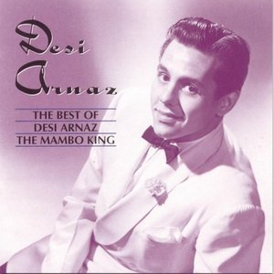
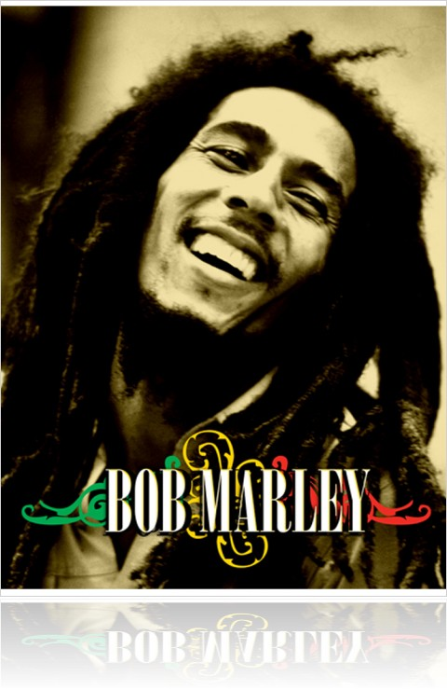
How Reggae Defeated Mambo
Notes:
When communism squelched popular music in Cuba, Jamaica took over as cultural capital of the Caribbean
Havana in the 1950s was Las Vegas with beaches. Affluent North Americans escaped to Cuba to indulge in cigars, sex, rum, and affordable luxury. Leading hotels and casinos boasted of dance halls and large orchestras. Modeled after popular New York orchestral combos, these tourism-generated bands infused popular music from the United States with the instruments and rhythms of Cuba, Africa, and the Caribbean.
The result was explosive. The mambo quickly busted out of the glitzy cabarets and into the buzzing streets of Havana. Small, private social clubs, of the type immortalized in the 1999 documentary Buena Vista Social Club, began springing up on every street corner. Organized by neighborhood, by occupation, and by social status, these clubs helped nurture a strong community-based sense of the new Cuban music.
Like so much Cuban-American culture before the two countries became bitter adversaries, Havana’s mambo craze leapt back across the Florida Straits to a willing United States. New York Jazz musicians began incorporating Cuban elements into their music. Pop singers such as Nat “King” Cole began recording with musicians in Cuba and singing in Spanish. Cuban artists such as Beny Moré and Celia Cruz found themselves at the fore of a new, syncretic movement in pan-American popular music.
And decades before cultural observers would enthuse over the “crossover” appeal of Jennifer Lopez and Shakira, Yankee audiences threw their arms around Cuban percussionist Desi Arnaz, whose mambo band-leader character Ricky Ricardo co-anchored the most popular show on American television, I Love Lucy.
At the height of ’50s mambo fever, you would have been laughed out of the room had you predicted that comparatively tiny and impoverished Jamaica would soon become a dominant force in global music, while the Caribbean’s longstanding cultural capital of Havana fell into irrelevance and decay. But the rise of communism and its attendant cultural protectionism soon choked off mambo and Cuban creativity at the source, while Jamaica’s economic boom and unfettered recording industry uncorked a revolutionary new music called reggae.
The glossy exterior of Havana’s nightlife concealed something much darker. Dictator Fulgencio Batista demonstrated little regard for the constitution he had created more than a decade earlier. Racial and social divides ran deep, free speech and assembly were severely curtailed, and the wealth brought in by the booming tourist trade was seen as benefitting only the well connected.
On July 23, 1953, a group of revolutionaries led by Fidel Castro attacked the Moncada Barracks in Havana. While easily thwarted, the attack marked the beginning of what would be the Cuban Revolution. After a brief prison stint, the bearded revolutionary fled to Mexico, then returned in December of 1956 with Argentinean physician and military strategist Che Guevara and 80 men. Taking to the Sierra Maestra Mountains, and shoring up support from rural workers and farmers, Castro and company began what would be a two-year war against the Batista regime. On New Year’s Day 1959, Batista fled to the Dominican Republic, and Fidel Castro began his long victory march to Havana.
Initially, many musicians were optimistic about the new Cuba. At last they would be able to explore their craft free from the constraints of the market. Class and race would no longer divide people, and artists would now be able to freely connect with all Cubans instead of merely catering to visiting Americans. Most non-headlining musicians saw an initial increase in income, and composers were afforded the security of a regular salary. Cultural education programs strove to valorize domestic music and raise the musical literacy of all Cubans.
But this new musical economy was unsustainable. The casinos were looted and shuttered within days of the revolution. Hotels were commandeered, and tourists stopped coming. With the engine of the economy cut, more and more clubs found it impossible to stay open. By January 1960, the government had taken over most performance venues. And by the summer of 1960, Cuba’s numerous radio and television networks were nationalized.
A musician wishing to be heard in Cuba now required government approval. Opportunities to perform abroad were limited to state-sponsored tours, and formal approval was required even to travel anywhere on the island. Cuban musicians, who once roamed as far as their talents could take them, now found their ability to share their works dependent upon the state’s assessment of their loyalty to the Revolution. And it was not only professional musicians who were silenced: The Social Clubs, so vital to the musical soul of the island, were declared un-egalitarian and abolished.
By 1961, all production facilities had been nationalized. State approval was required for any new recording. Censorship and bureaucratic red tape frustrated artists. Reduced tourism and trade cut Cuba off from its most lucrative markets, and the lack of profit motive meant that no one stood to make money by pushing new music or reissuing perennially popular recordings. Meanwhile, the deteriorating economy (exacerbated by the U.S. embargo) made money still more scarce. By 1966, Cuba, which used to press millions of records a year, only managed to eke out 184,000.
As his country moved much closer to the Soviet Union, Castro soon adopted Moscow’s model of arts production. To be a musician in socialist Cuba, one had to audition for a panel of conservatory-trained professionals who assigned the would-be performer a letter grade of A, B, or C. Given the background of the panel, it was only natural that those most proficient in classical European styles were assigned to the highest class, while those proficient in folk or popular styles would be diverted into lesser pools.
Popular styles of music such as jazz and early rock ’n’ roll were tolerated in the early days of the Revolution, but later years saw them labeled as imperialist, and effectively banned. (Even the Beatles were banned for several years on grounds of cultural imperialism.) Artists attempting the Cuban tradition of incorporating new rhythms and instruments into their styles were blacklisted from state radio and TV.
In 1968, a prohibitionist “Dry Law” closed Cuban clubs, leaving 40 percent of Cuban club musicians with no place to perform. In 1970, most were forced into the sugar fields as part of the communist state’s zafra de los 10 milliones, a desperate plot to save the Cuban economy with a massive, one-time sugar haul. Musicians had their instruments ripped from their hands and replaced with machetes. In just one decade, Havana went from being the wellspring of popular pan-American music to a desert of rigid, top-down culture.
The colonial island 90 miles south of Cuba had a much more modest musical pedigree at the time of the mambo boom. The first popular music documented in Jamaica was mento. Played on homemade string, wind, and percussion instruments in rural parts of the country as early as the 19th century, mento featured an even, playful gait and cheeky lyrics about daily life. Sounding similar to Trinidadian calypsos, mento did not start appearing on record until the 1950s, when entrepreneurs such as Ken Khouri and Ivan Chin sought to jump-start a domestic recording industry.
These early mento recordings did not sell particularly well in the face of regional competition from Cuba and Trinidad. The biggest hit of the era, Alerth Bedasse’s “Night Food,” caught the attention of the colonial government (Jamaica was ruled by Great Britain for three centuries until its independence in 1962) due to its provocative lyrics about a young man who is confused when an older woman invites him to sample the warm sweet night food, even though the room they are in is pitch black and he has no utensils. Trade and Industry minister Willis O. Isaacs personally attacked the song in an address to parliament, raising concerns about censorship, further discouraging investment in domestic recording.
But the 1950s would be a time of economic and political change in Jamaica. Global demand for aluminum was growing; the miracle metal was being used in everything from airplanes to TV dinner trays. By the end of the decade Jamaica would be the world’s leading producer of aluminum’s raw material of bauxite. Less labor intensive than farming, bauxite mining created a labor surplus and young Jamaicans poured in from the countryside in search of better opportunities.
Jamaicans began leaving the island to work on sugar and cotton plantations in the United States, replacing southern blacks who had left during the Great Migration. An estimated 174,000 Jamaicans also moved to the United Kingdom between 1953 and 1962, after which the British government abruptly cut off immigration from the newly independent state. Millions of pounds in remittances were sent to Jamaica every year.
Limited transportation and infrastructure had long handcuffed the country’s tourist industry. But after World War II, commercial travel and newly built hotels helped spur three decades of consistent economic growth. Jamaican GNP nearly doubled between 1952 and 1962. The years between 1940 and 1960 saw significant reductions in illiteracy and infant mortality, and a 10-year jump in life expectancy.
Jamaica was in the process of becoming urban and modern, and the young people who found themselves in the capital of Kingston were no longer interested in the “country” music of their past. Retailers began setting up speakers in front of their business in hopes of luring customers inside. Entrepreneurs such as hardware store owner Thomas Chin started renting out mobile sound systems for parties.
By the mid-1950s the sound system was the center of Kingston nightlife. Hotels and tourist clubs did not welcome locals, and state radio catered to a conservative affluent audience, so the sound-system dance was the place most Jamaicans went to show off their wares and hear new tunes. An underground economy grew around the dances: Organizers charged admission, DJs received a fee, and food and alcohol vendors lined the streets around the venue.
Competition between DJs was intense, and customer feedback immediate. The hottest music in 1950s Kingston was American jazz and rhythm and blues. DJs paid a premium for records by artists such as Rosco Gordon and Fats Domino. Records were imported or bought off boat workers coming from the United States. Many DJs actually got their start working as migrant laborers in the United States, using the money they earned to collect equipment and records. A new breed of music entrepreneurs was just beginning to build the infrastructure needed for Jamaican music to flourish.
While popular music was withering in Cuba, it was beginning to bloom in Jamaica. The growth of Jamaican tourism, in part spurred on by the collapse of Cuban tourism, created plenty of opportunities for musicians. Given the high rates of youth unemployment, joining a hotel band was a good career option.
The island was also beginning to discover its own great pop singers. Vere Johns, a Jamaican journalist and well-traveled entrepreneur, began hosting a talent show on RJR radio, broadcast from the Palace Theater. Singers battled it out over pop and R&B songs, and the crowd, composed of Jamaicans from all classes (due to the availability of cheap seats), would pick the winner through their cheers. The show launched the careers of many important artists, including the eventual king of ska Derrick Morgan, who went on to record Jamaica’s first international hit record; Millie Small, and even the band from which The Legend himself, Bob Marley, would emerge, The Wailers.
Mobile DJs, always looking to stay ahead of the competition, began recording their own music. At first they tried to mirror the rhythm and blues records—particularly the jerking piano boogies of artists like Rosco Gordon and Professor Longhair—that were so popular at sound system dances. Soundman Clement “Coxsome” Dodd originally recorded Theo Beckford’s classic “Easy Snappin’ ” in 1956 as a “sound system special”—a song you’d only hear live at the dance. Coxsome didn’t release the record for sale until 1959, at which point it instantly topped the Jamaican charts.
Exclusive recording contracts and publishing rights were nonexistent at the time, leaving plenty of artists disgruntled about never getting their due or proper compensation. But the anarchistic sound wars produced some of the most important recordings in Jamaican musical history.
One of the transformational figures in 1960s Jamaican music was Cecil Bustamente Campbell, better known as Prince Buster. An accomplished boxer and unflappable tough guy, Buster caught the attention of Coxsome, working not only as a strongman for the DJ turned producer, but also as a curator, who with one listen could name the artist and title of rival DJ’s selection.
Around this time many unemployed youth had begun hanging out in a Trenchtown yard with a group of mystics known as Rastafarians. Many musicians who played on early ska records began bringing their horns to the yard to jam with the rasta drummers, who performed layered, syncopated rhythms in a West African style. While a Muslim, Buster appreciated the new possibilities brought on by the inclusion of African drumming, and in 1960, while recording the vocal group The Folkes Brothers, he invited rasta drum guru Count Ossie to join the session. The resulting record, “Oh Carolina” was an immediate hit and a turning point in Jamaican music
Ska began sounding less and less like Jamaican imitations of music from New Orleans and more like something altogether unique. The rigid, offbeat “ska-ska” of the guitar and piano that gave the music its name became looser, and the bass abandoned its supporting role to become the prime mover behind the sound systems’ massive walls of speakers. Jamaica was a new nation, with a unique identity and its own new popular music.
As the Kingston music scene grew, musicians from throughout the Caribbean found their way to Jamaica. Trinidadian guitarist Lynn Taitt advocated for the exploration of different tempos and began incorporating counter lines common to calypso music. The bouncing bass, slower tempo, and bubbling guitar line heard on Hopeton Lewis’ 1966 hit “Take It Easy” would usher in the beginning of rocksteady. This music, with its layered guitars (one chunking out chords, while another provided dancing, muted melodies), its free, earthshaking bass, and popping, syncopated drums, laid the foundation for reggae.
While the political wars between the island’s two union-based parties (the Jamaica Labour Party and the People’s National Party) was threatening the stability of the fledgling nation, Jamaican music continued to evolve and respond to the times. Musicians and producers—particularly Rastafarians who had a long tradition of political cynicism—turned out anthems criticizing the political turmoil and violence. People began using the word reggae to describe the scruffy, loose music of the late ’60s produced by a new generation of artists ready to challenge the old sound-system guard. The 1970s would see the audience for Jamaican reggae music explode, changing popular music around the globe.
The man who brought Jamaican music to the world was Chris Blackwell, a British citizen whose ties to Jamaica dated back to the 17th century. Blackwell had been recording Jamaican music as early as 1958, and was one of the most prominent record distributors in the burgeoning days of the sound system. As a producer, Blackwell would score his first international hit with Millie Small’s “My Boy Lollipop,” a record that not only sold well within the U.K.’s West Indies community, but found crossover success, with Small even sharing a TV spot with The Beatles.
Blackwell felt that the world was ready for a global reggae mega-star, and saw potential in The Wailers, particularly their charismatic frontman Bob Marley. Jamaican music had been on the verge of breaking internationally for a few years, but Blackwell realized that the popular audience for the music would not be found in the black community, but rather the white counterculture.
By adding a few distorted guitars and marketing the Wailers as a rock band, Blackwell thought his hand-picked group could cross over to international superstardom. The Wailers 1973 Catch A Fire was indeed an instant classic, introducing much of the world to the music that had been shaking Jamaica for the past decade. By the mid-’70s reggae had a firm foothold in the U.S. and the U.K. as both a high-valued import product and a style worth mining by acts like The Clash and even The Rolling Stones.
What accounts for the major divergence between Cuban and Jamaican popular music in the 1960s and beyond? Control. The socialist government of Cuba set out to preserve and promote culture through top-down programs that stifled competition and expression, providing little incentive to cater to anyone other than those in power. In Jamaica, popular opinion drove the sound systems and fierce competition between musicians and producers led to a tremendous period of innovation. Cuba created an orderly system for music education that produced little of lasting value; Jamaica’s disordered economic growth produced a global phenomenon whose reverberations are still being felt.
While sound system dances, like Jamaican life itself, were not free from police harassment, the culture continued and was never banned outright the way Cuban social clubs were. Travel restrictions, bans, and embargos cut Cuban musicians off from their regional audience and the Cuban diaspora, and even the most popular Latin American musical genre of the ’60s and ’70s—salsa—excluded the country whose tresillo rhythm (three notes in a long-long-short pattern) provided its backbone. Jamaica, on the other hand, maintained steady lines of regional and international trade, consistently seeding the island with new music and equipment, while building a strong market abroad.
In December 2012 Raul Castro, ruling the island after his ailing brother Fidel, announced that reggaeton—the Spanish language rap style set to Jamaican dance hall beats that has come to dominate Latin America in recent years—would be banned from the public places. Once again the Cuban people are being protected from popular music deemed to be imperialist and debasing.
But as the example of Jamaica reveals, music cultures can thrive in competitive environments. And personal and economic freedom can strengthen local culture rather than debase it, creating music so unique and infectious that imitators will spring up on the other side of the globe.

Slide 41
Lesson 4
Incentives & Economic Freedom
Notes:
How important is economic
freedom to a nation’s prosperity?
Is it a cause of economic success
or a correlation variable?
Does economic freedom
incentivize improved productivity?

Slide 42
Noncontroversial
Economic freedom means that people are free to
trade with others, compete in markets, buy what
they want, earn a living in a job they choose,
keep what they earn, and own things privately.
Controversial!
The Economic Freedom Hypothesis:
As a country allows greater degrees of
economic freedom, that country will
experience greater degrees of economic success.

Slide 43
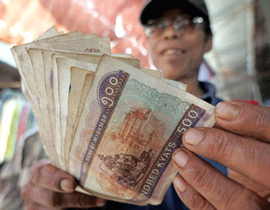
Economic Freedom & Prosperity
Notes:
Look at the data on the EFW Map that relates economic freedom to (1) Income per Person, and (2) Annual Growth in Income per Person. Note how the two are correlated with levels of economic freedom.
Play incentive sketch

Slide 44
Incentives
Anticipated costs
or benefits,
monetary and nonmonetary,
that influence individual choices.
Notes:
Show clip from ?? Talk about positive incentives
Show clip from Russian pedestrians. Talk about perverse incentives. Excessive regulation can lead to large informal ecoomicies.
Students learn the definition of incentives and examine several examples where positive incentives influence human behaviour before drawing their own conclusions about the causes of economic well-being.
Definition of Incentives: Anticipated costs or benefits, monetary and nonmonetary, that influence individual choices.

Slide 45
What Happens if You Change the Rules?
Taxi cab owners…
Own their own business, hire their
drivers, and lease or own their cars
Would like to expand their
business and increase profits
Notes:
Part 1: Think Pair Share
Pass out Handout 4.1
How do you think their behaviour would change if the following rules were instituted?

Slide 46
Think-Pair-Share
Which polices are negative incentives for taxi owners?
Which policies are positive incentives for taxi owners?
Which policies seem to contribute to
increased taxi services for consumers?
4. Which policies seem most consistent with
the economic freedom definition on the map?
5. Do economic freedom policies appear to have a
causal or accidental relationship to expanding
economic activity and increasing income levels?
Notes:
Which polices are negative incentives for taxi owners? (1,3,4,5,8, 10)
Which policies are positive incentives for taxi owners? (2,6,7,9)
Which policies seem to contribute to increased taxi services for consumers? (2,6,7,9)
Which policies seem most consistent with the economic freedom definition on the map? (2,6,7,9)
Do economic freedom policies appear to be a causal or accidental relationship to expanding economic activity and increasing income levels? (They appear to be causal, but the question continues to be studied in economic research.)
In London, it is illegal to flag down a taxi if you have the plague....or smallpox...... http://www.huffingtonpost.com/2013/09/04/crazy-cab-law_n_3860964.html (some of this is so bizarre it is funny, especially the picture of the bear hanging out of a cab window at the end).
In NYC the taxi commission (see question #8) requires all licensed cabs to have a medallion. The number of medallions has been limited since the 1930s and a single medallion is now worth around $300,000....great example of an artificial barrier to entry!
This last one is my favorite and it just became law in 2012. http://www.cnn.com/2012/06/29/us/new-laws/ It is a special "vomit" fee in Illinois....there is a nice picture of the cab fees that might make a great slide.
This lesson helps students investigate the influence of incentives with regard to economic freedom and economic prosperity. It appears that increased economic freedom creates an environment with positive incentives which reward people for becoming more productive. Other factors, such as war, political corruption and absence of civil liberties may interfere and reduce the gains from improved economic production, but the economic freedom hypothesis is supported both by economic prosperity data and compelling logic regarding the influence of incentives on human economic activity. Positive incentives encourage people to be more productive.

Slide 47
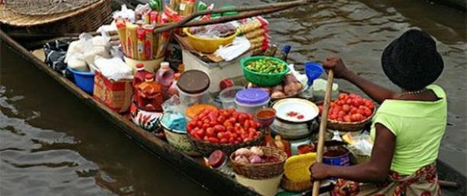
Lesson 5
Economic Growth and Economic Freedom
Notes:
Play “World on Fire” during the break http://www.youtube.com/watch?v=FDmPcSWE0WU

Slide 48
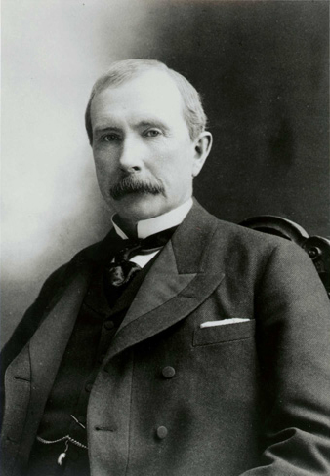
Would you trade lives with
John D. Rockefeller?
Text a keyword to 37607
ROCKAFELLA
ILIKEME
100 years ago, John D. Rockefeller’s wealth neared 1B.
Notes:
In today’s dollars, that is 200B, which is more than double the richest persons alive today.
Choice: You’d have to give up many modern advances of the last 100 years.
Cost: Those advances in medicine, travel, air conditioning, tv, internet, all have enormous value and incur an opportunity cost.
Incentives: There is the prestige of being the “richest” versus the practical tradeoffs involved in giving up so many time saving advances.
Voluntary trade: You’d only go back if you perceived that the benefits of doing so outweighed the costs.

Slide 49
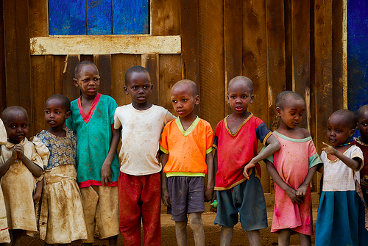
Economic freedom ➔
economic growth ➔ decreased poverty
Extreme poverty: living on less than $1.25 per day
Moderate poverty: living on less than $2.00 per day
Notes:
Check new number!
In 2001, about 2.7 billion people lived in moderate or extreme poverty
In 2009, about 2 billion people lived in moderate or extreme poverty
http://www.youtube.com/watch?v=6YzEKG-nvgE
Poverty is reduced when economic growth or the growth of real gross domestic product per person increases. A pro-economic-freedom agenda may be the best anti-poverty agenda.
Economic growth is a measure of the ability of an economy to increase its total output of goods and services. If a nation’s economy grows, incomes will be higher and the standard of living of its people will be better. If the economy grows at a higher rate than its population, there will be more goods and services to be divided up by the people. In most cases, this means people have a higher standard of living and better housing, a healthier diet, improved health care and a longer life expectancy. Strong economic growth means life is getting better. Because it considers population growth, annual growth in per person real gross domestic product is a good measure of economic growth. A nation’s gross domestic product or GDP is the total output of final goods and services. If it is real GDP, it is adjusted for inflation. If it is real GDP per person, it is the real GDP divided by the country’s population. Increasing per person real GDP is a not a guarantee that everyone will live better; not everyone will benefit equally from the growth of the economy. However, in most cases, increases in per person real GDP improve life for the people who live in a country.
Even small increases in per person GDP are important because the growth of an economy is compounded over time just like the growth in a savings account. In fact, if you divide the economic growth rate into seventy, you will get the approximate number of years it takes an economy to double in size.

Slide 50
Highest annual growth countries | Economic freedom index, 2009 | Map classification, 2009
China
South Korea
Myanmar
Bostwana
India
Thailand
Mauritius
Singapore
Hong Kong
Ireland
Notes:
In this activity, economic growth is defined as the annual increase in real gross domestic product per capita.
The chart is ordered from highest to lowest annual growth.
How does economic freedom relate to economic growth?
The students first analyze the relationship between economic freedom and economic growth and explore why this positive relationship exists.
To do this, they analyze the nations with the lowest annual growth rates and those with the highest annual growth rates.

Slide 51
Highest annual growth countries | Economic freedom index, 2009 | Map classification, 2009
China | 6.43 | RU
South Korea | 7.32 | MF
Myanmar | 4.46 | MU
Bostwana | 6.83 | RF
India | 6.40 | RU
Thailand | 6.87 | RF
Mauritius | 7.67 | MF
Singapore | 8.68 | MF
Hong Kong | 9.01 | MF
Ireland | 7.38 | MF
Notes:
In this activity, economic growth is defined as the annual increase in real gross domestic product per capita.
How does economic freedom relate to economic growth?
The students first analyze the relationship between economic freedom and economic growth and explore why this positive relationship exists.
To do this, they analyze the nations with the lowest annual growth rates and those with the highest annual growth rates.

Slide 52
Which city is this?
Shanghai!

Slide 53
Lowest annual growth countries | Economic freedom index, 2009 | Map classification, 2009
Nicaragua
Sierra Leone
Zambia
Burundi
Togo
Gabon
Central African Republic
Madagascar
Niger
Côte d’Ivoire
Notes:
In this activity, economic growth is defined as the annual increase in real gross domestic product per capita.
The chart is ordered from highest to lowest annual growth.
How does economic freedom relate to economic growth?
The students first analyze the relationship between economic freedom and economic growth and explore why this positive relationship exists.
To do this, they analyze the nations with the lowest annual growth rates and those with the highest annual growth rates.

Slide 54
Lowest annual growth countries | Economic freedom index, 2009 | Map classification, 2009
Nicaragua | 6.82 | RF
Sierra Leone | 5.62 | MU
Zambia | 7.26 | RF
Burundi | 5.12 | MU
Togo | 5.74 | MU
Gabon | 5.82 | MU
Central African Republic | 4.88 | MU
Madagascar | 6.29 | RU
Niger | 5.44 | MU
Côte d’Ivoire | 5.86 | MU
Notes:
In this activity, economic growth is defined as the annual increase in real gross domestic product per capita.
How does economic freedom relate to economic growth?
The students first analyze the relationship between economic freedom and economic growth and explore why this positive relationship exists.
To do this, they analyze the nations with the lowest annual growth rates and those with the highest annual growth rates.

Slide 55
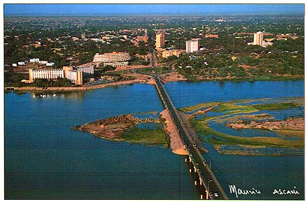
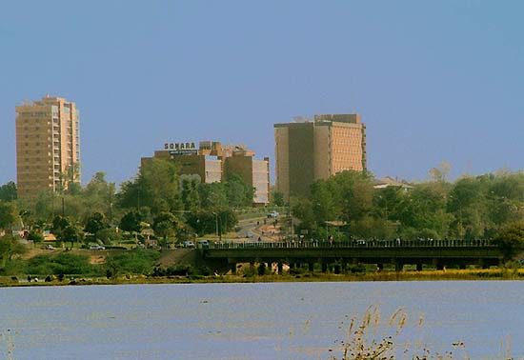
1992
Which city
is this?
2011
Niamey!
Notes:
Niamey, Niger
Can you identify the same buildings in each picture?
Go to Tripadvisor for hotel and restaurant selection!

Slide 56
Think-Pair-Share
In general, do the highest-growth countries or
the lowest-growth countries have higher levels
of economic freedom in 1980? In 2009?
2. If China continues its annual growth of per person GDP, how
many years will it take China to double its per person GDP?
3. How many highest-growth countries are classified
as “mostly free” or “relatively free” in 2009?
4. How many highest-growth countries increased their economic freedom index score from 1980 to 2009 by more than one point?
5. China has the highest economic growth rate in the world, yet is classified as “relatively unfree” in 2009. How do you explain this?
Notes:
Highest growth
2. 70/8.9 = 7.87
3. 7
4. 3
5. Though still RU, it has increased it’s EF score by 2.45 points. It has changed from a centrally controlled economy to a mixed economy. With a private business sector. It engages in foreign trade. The main reason it is RU is it’s large government

Slide 57
Think-Pair-Share
6. The lowest-growth nations have negative growth in per person GDP. What does this mean for the people of these countries?
How many of the lowest-growth countries are
classified as “mostly free” or “relatively free” in 2009?
8. In which continent are most of the lowest-growth countries?
How many African countries are among the 10 highest-growth countries? How does their economic freedom differ from
The African countries on the 10 lowest-growth list?
10. Read the chart “Real income per person, 1990-2009.” What’s
the economic growth rate of mostly free countries? Mostly unfree?
Notes:
6. Standard of living is declining.
7. 2
8. Africa
9. Botswana is RF. Mauritius is MF
10. 3.07; 1.18

Slide 58
Think-Pair-Share
11. Using the rule of 70, how long will it take the mostly free countries to double their per person GDP? Mostly unfree?
12. How does the level of economic
freedom relate to economic growth?
13. Can you think of any reason other than the level of economic freedom that would account for the difference in the economic growth rates of highest-growth countries & lowest-growth countries?
14. If you were advising the 10 lowest-growth countries, what would you tell them to do to increase their future economic growth?
Notes:
11. 22.8; 59.3
12. More freedom = more growth (Myanmar data is suspect; Nicaragua & Madagascar are only recently free)
13. Read answer key!
14: Increase their freedom (and the 5 factors that comprise it)!
Economic freedom is correlated strongly with economic growth. Without a doubt it is hard to prove that it is a causal relationship, but it definitely suggests that developing nations might increase their economic growth if they increase economic freedom.

Slide 59
Which country is this? (Text MYGUESS and your choice to 37607)
Life expectancy is 47 years
Almost nobody owns an automobile
Income per person is roughly $5,000
Most people live less than a mile from their job
Only about one third of homes have running water
About 140 of every 1,000 children die before their 1st birthday

Slide 60
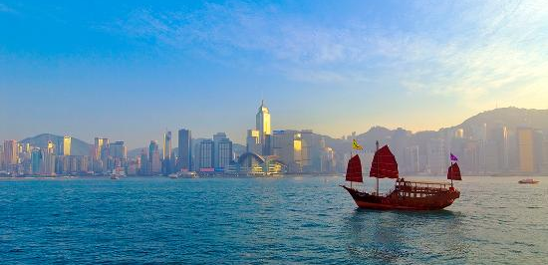
Lesson 6
Alternative economic policies:
Which ones increase economic freedom?
Notes:
Explain and pass out handout 6.1. Allow “committees” time to vote on each policy.

Slide 61
Queue No More!
To reduce health care
wait time for Canadian
citizens, allow medical
personnel to establish
private practices so
patients can purchase
instant medical care
when they want it.
Notes:
Increases economic freedom

Slide 62
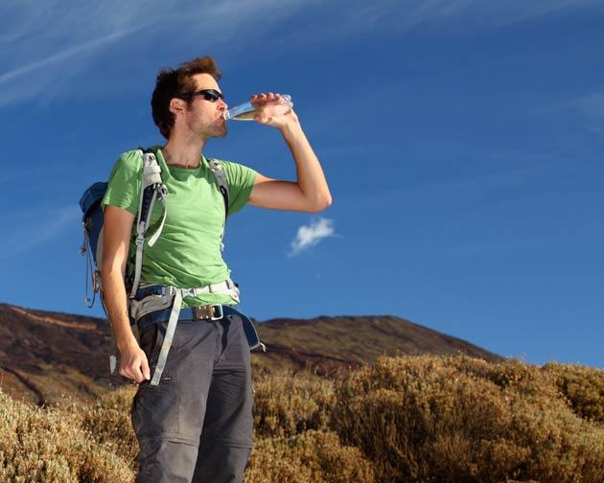
Quench the Thirst!
Allow private companies
to buy fresh water from lakes in Newfoundland and British Columbia and sell it to thirsty locations like Arizona and Florida.
Notes:
Increases economic freedom

Slide 63
Support Canadian Wineries!
To encourage Canadians to support the growing Canadian wine industry, ban the sale of all foreign-produced wine in Canada.
Notes:
Decreases economic freedom

Slide 64
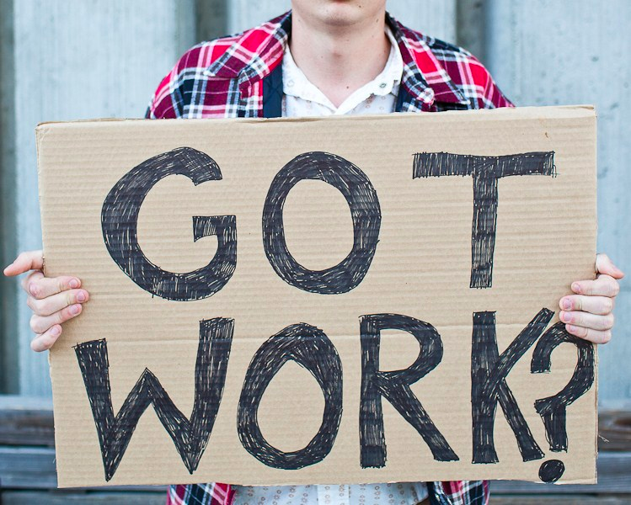
Reduce Unemployment!
To provide jobs for more Canadians, reduce the legal workweek from 40 hours to 35 hours and ban overtime work.
Notes:
Decreases economic freedom

Slide 65
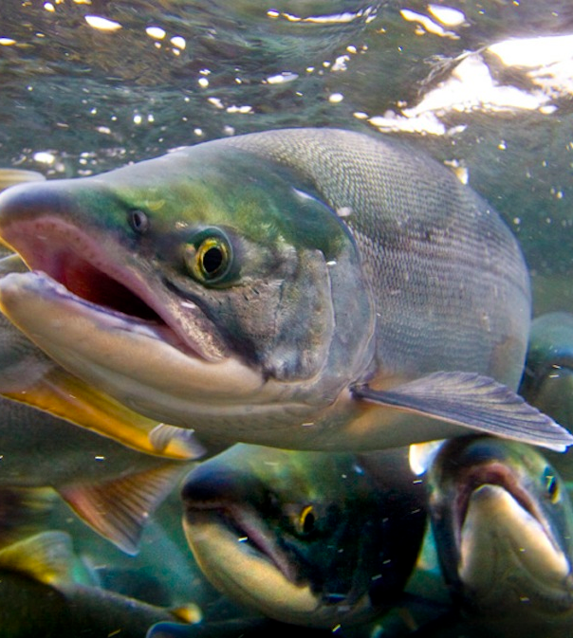
Save the Fish!
Allow private companies,
private environmental
groups, and individuals to
own the rights to salmon
and steelhead spawning grounds, as well as the
rivers & streams the fish
use to migrate to those grounds.
Notes:
Increases economic freedom

Slide 66
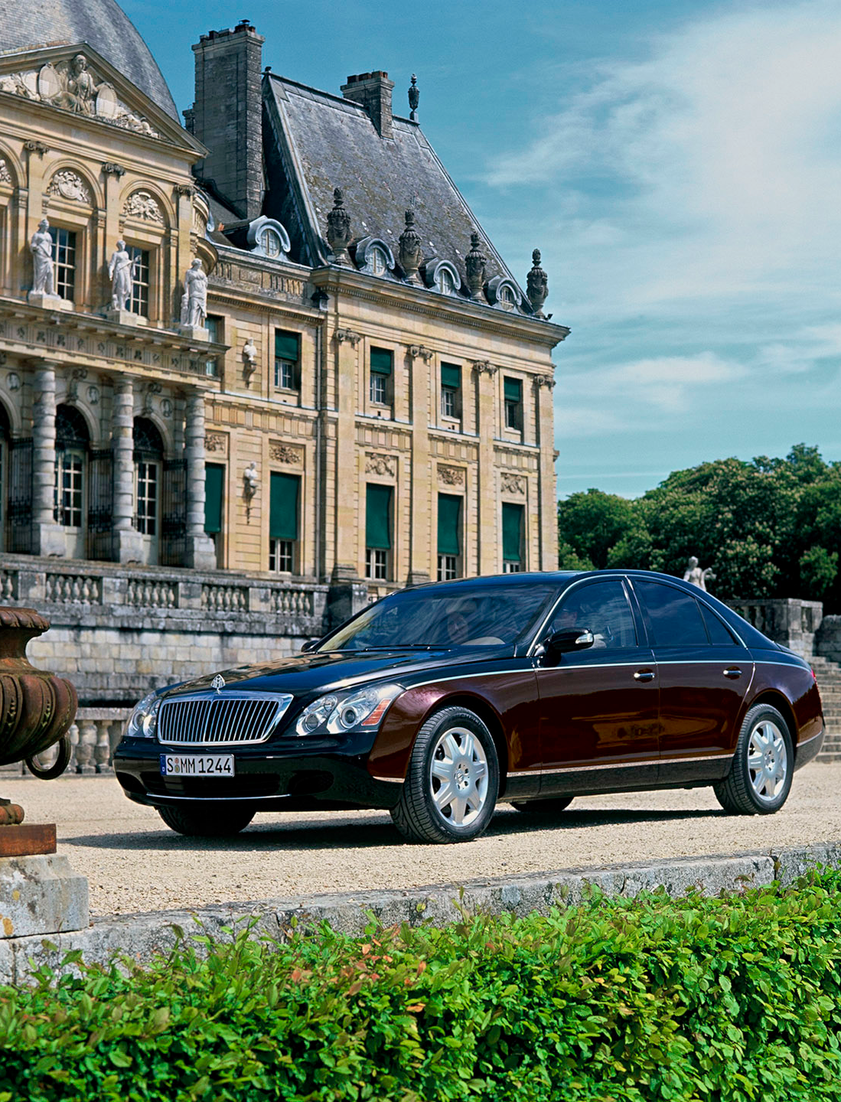
Spread the Wealth!
Redistribute generational
wealth by limiting what one can inherit. Estates under$200K are passed on to the heirs. Those over $200K
are collected & distributed equally to provincial citizens.
Notes:
Decreases economic freedom

Slide 67
Buy Local!
To encourage citizens
To eat local, fresh, organically produced
food, grocery stores can
sell only locally grown produce, meat, & fish.
Notes:
Decreases economic freedom
Learning to use the economic freedom criteria accurately will help students evaluate policy proposals and anticipate the consequences of the proposals. It is important for students to recognize and debate these economic freedom changes in Canada. Economic freedom is an important part of Canadian culture.

Slide 68
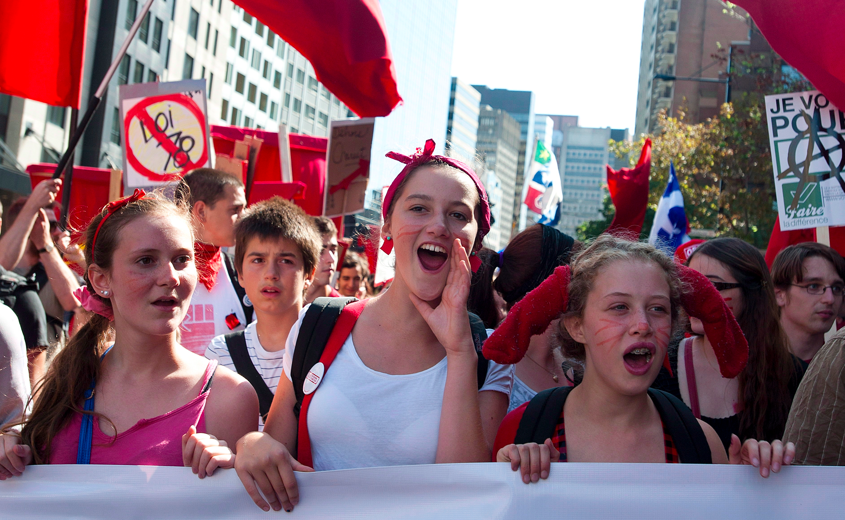
Why is it important for students in
a democracy to understand
economic freedom and it’s benefits?
Notes:
They will be voters soon. The level of economic freedom in a democracy is dependent on voters to increase or decrease it depending on the policies they support as voters.

Slide 69
Lesson 7
Changes in EFW, 2004-2009

Slide 70
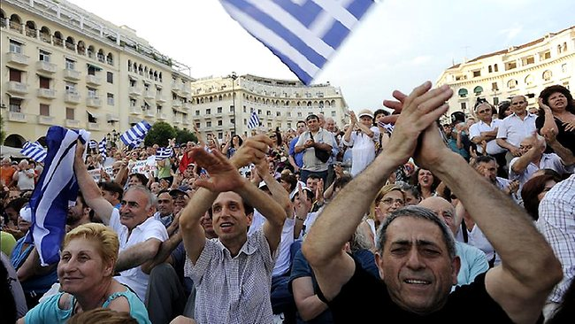
Changing Levels of Economic Freedom
Policies • Countries • World
Notes:
The EFW report is conducted and published annually. It is informative to two purposes:
To see if EF is increasing or decreasing worldwide,
To see how economic freedom is changing in individual countries.

Slide 71
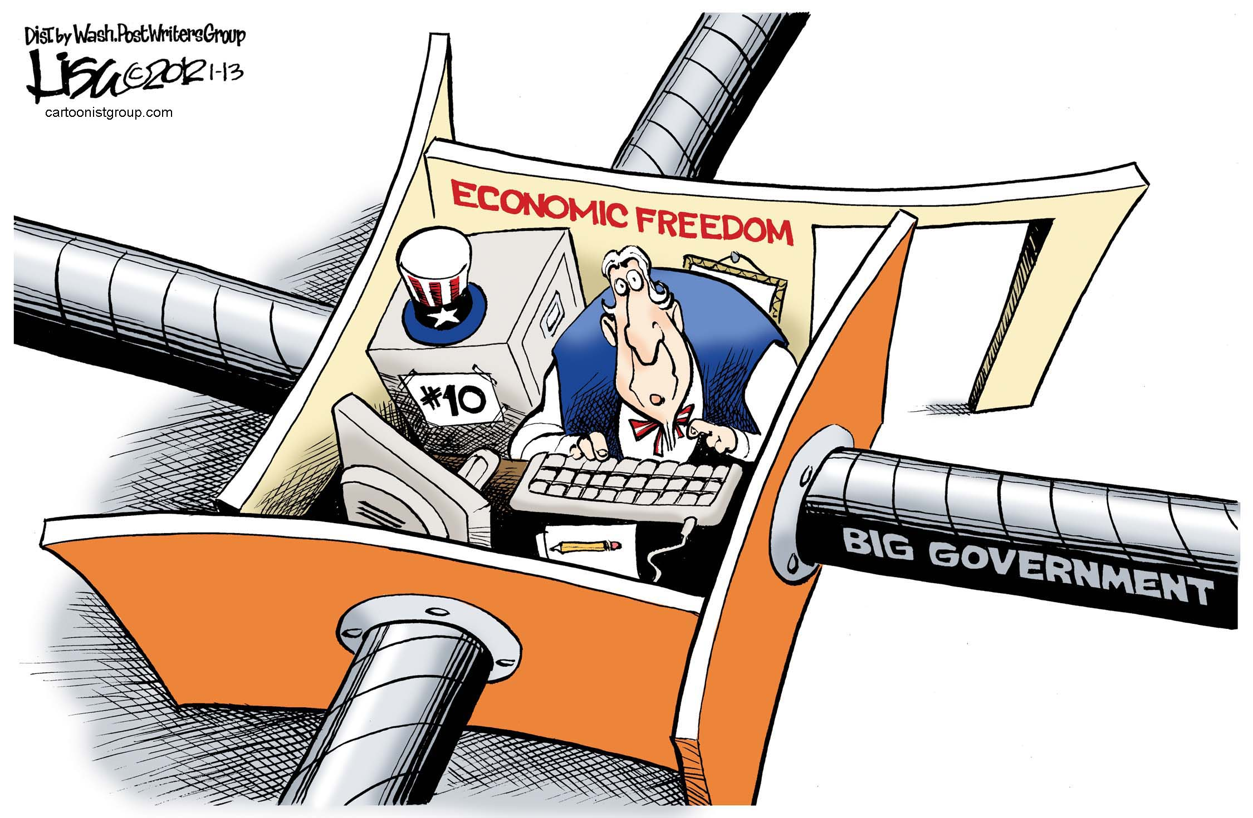
Lisa Benson Editorial Cartoon, used with the permission of Lisa Benson,
the Washington Post Writers Group, and the Cartoonist Group. All rights reserved.
Notes:
Economic freedom has been declining in recent years. (Actually, it’s back up in 2011)
Talk instead about how recessions may lead to loss of economic freedom
The EFW index declined from 6.74 in 2007 to 6.64 in 2009.

Slide 72
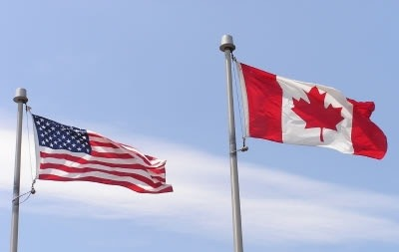
Find the ranking and index number from 2004 and 2009 for each of the following countries.
Australia
Canada
Denmark
Germany
Ireland
Italy
New Zealand
Switzerland
United Kingdom
United States
Notes:
Add pic
Handout 7.1
Students are asked use two EFW maps to compare the levels of economic freedom in selected countries and write a short paragraph describing the changes.

Slide 73
Changes in ranking and index number from 2004 to 2009
Country | Index number | Ranking
Australia | Up | Up
Canada | Down | Up
Denmark | Down | Up
Germany | Down | Down
Ireland | Down | Down
Italy | Down | Down
New Zealand | Same | Same
Switzerland | Down | Down
United Kingdom | Down | Down
United States | Down | Down
Notes:
Handout 7.1 Answer Key

Slide 74
Think-Pair-Share
1. Which countries raised their index
number? Which raised their ranking?
2. Which countries lowered their index
number? Which lowered their ranking?
3. Which two European countries
dropped the most in their ranking?
4. What were the rankings for
Canada and the US in 2004? In 2009?
5. In general, what happened to economic freedom
in these countries after the 2008 recession?
Notes:
Handout 7.2
Australia; Australia, Canada, Denmark
Canada, Germany, Denmark, Ireland, Italy, Switzerland, UK, US; Germany, Ireland, Italy, Switzerland, UK, US
Italy & Ireland
8th & 3rd, respectively
It fell

Slide 75
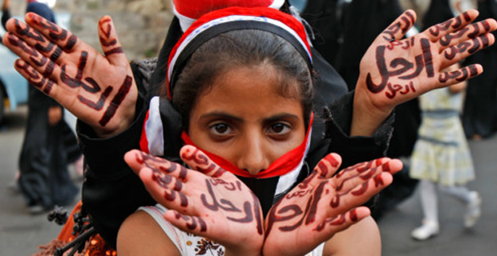
Economic freedom is not a static situation!
Notes:
It can change dramatically when countries experience revolutions, undergo fiscal crises, or enact policy changes in response to recessions.

