Slide 1
Competitiveness: Through Productivity or Dependency?
John Garen
Professor, Department of Economics, Gatton College of Business and Economics, University of Kentucky
Faculty Network Member, Mercatus Center
Board of Scholars, Bluegrass Institute

Slide 2
Outline of the Talk
Some information on Kentucky’s situation: low income, low productivity, high dependency.
The dependency trap.
How to compete via productivity? What is government’s role?
How is Kentucky doing in this regard: taxes and spending.

Slide 3
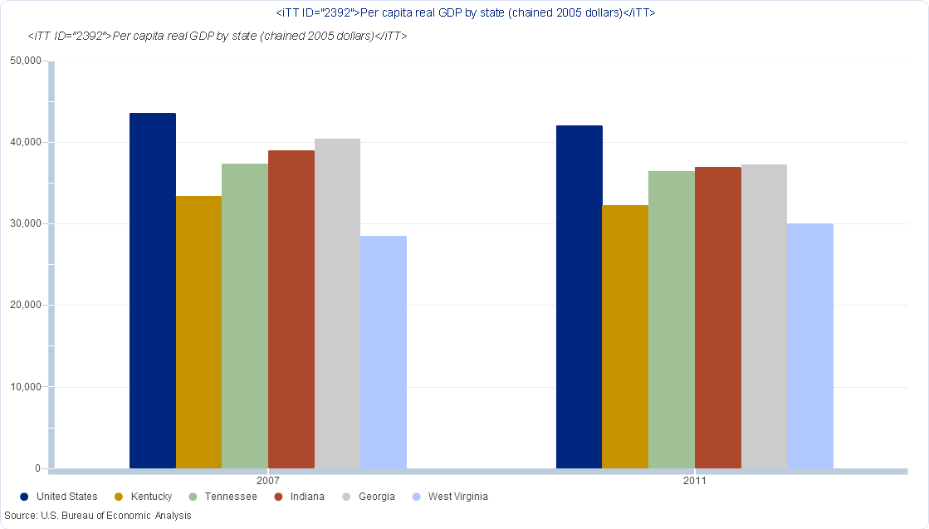
GDP Per Capita

Slide 4
Source: Bureau of Economic Analysis, http://www.bea.gov/iTable/iTable.cfm?reqid=70&step=1&isuri=1&acrdn=4#reqid=70&step=1&isuri=1.

Slide 5
Work Effort: Labor Force Participation, 2007
Source: Bureau of Labor Statistics, http://www.bls.gov/lau/#ex14 .

Slide 6
Job Skills: Education
Source: Bureau of Labor Statistics, http://www.bls.gov/sae/.

Slide 7
Kentucky’s Rank on Health Indicators
Source: U.S. Department of Health and Human Services, http://www.healthstatus2020.com/disparities/ChartBookData_list.asp .
 | State Rank
Heart disease | 48
Coronary heart disease | 39
Total cancer | 54
Stroke | 43
Chronic obstructive pulmonary diseases (age 45 & over) | 51
Diagnosed high blood pressure (2007-2009) | 49
Obesity (2008-2010) (age 20 & over) | 49
Smoking currently (2008-2010) | 53

Slide 8
Personal Dependency: Transfer Income Relative to Total Income
Source: Bureau of Economic Analysis, http://www.bea.gov.

Slide 9
State-Level Dependency
Source: NASBO, http://www.nasbo.org/sites/default/files/State%20Expenditure%20Report_1.pdf.

Slide 10
How To Move Ahead
More Dependency or More Productivity?

Slide 11
The Dependency Trap
Federal inducements:
- Explicit federal matching like Medicaid: Ky. pays $.25, feds pay $.75.
- Projects w/o an explicit match rate: Ky. receives federal dollars, but pays 1/50th (or less) of the federal taxes to pay for it.
The cost of a federal dollar is less than a dollar.
Incentive to expand programs, lobby for projects.

Slide 12
An Illustrative Example
Lobby or not for a $100 million project. Value to each state is $30 million. Each state pays 1/50th of the taxes to support.
My state lobbies and gets a project:
State Benefit: $30 million
State Cost: $ 2 million
Cost to Other States: $98 million
Every state lobbies and gets a project. Total cost is 50 x $100 million.
Each State Benefits: $30 million
Cost Per State: $100 million
These ideas apply to the Medicaid expansion; state health insurance exchanges.

Slide 13
Competing Via Productivity
More productivity: a positive sum “game.”
What goods and services do people want? How to produce – and trade – those goods?
How to encourage individuals and businesses to invest in these productive activities . . . rather than adopting unhelpful investments, lower work effort, unhealthy lifestyles?

Slide 14
Fundamentals of Social Organization
Friedrich Hayek:
The economic problem “ . . . is rather a problem of how to secure the best use of resources known to any of the members of society, for ends whose relative importance only those individuals know.”
“The Use of Knowledge in Society,” American Economic Review, 1945.
Decision making and rewards must be decentralized. Individuals decide; no central planner.
Milton Friedman:
“’What can I and my compatriots do through government’ . . . to achieve our several goals and purposes . . ?”
Capitalism and Freedom, 1962.
Limit government to functions that enable individuals to peacefully pursue their interests.

Slide 15
The Functions of Government . . . and the “Secret” to Success
Providing a legal infrastructure: protection of lives and property; establishing effective criminal, contract, property, tort law.
Providing certain physical infrastructure: roads, sewer systems.
Dealing with externalities, e.g., pollution.
Promoting competition; preventing monopoly.
A social safety net.
Pay for it via the least distorting (disruptive) way.

Slide 16
How is Kentucky Doing on These Criteria?
Taxation:
- state and local tax payments are not
especially low
- state government dominates local regarding
tax and spending
- taxation is skewed toward income taxes,
away from property taxes, and has numerous
loopholes
Each of these is problematic

Slide 17
State Taxes Per Capita
W. Hoyt, W. Fox, M. Childress, J. Saunoris, Report to Governor’s Blue Ribbon Commission on Tax Reform by Economic Consultants, Univ. of Kentucky, Gatton College CBER, Sept. 2012 http://ltgovernor.ky.gov/taxreform/Documents/20120919/20120920_ConsultantReport.pdf.

Slide 18
State Plus Local Taxes Per Capita
W. Hoyt, W. Fox, M. Childress, J. Saunoris, Report to Governor’s Blue Ribbon Commission on Tax Reform by Economic Consultants, Univ. of Kentucky, Gatton College CBER, Sept. 2012 http://ltgovernor.ky.gov/taxreform/Documents/20120919/20120920_ConsultantReport.pdf.

Slide 19
State Share of State and Local Tax Revenue
W. Hoyt, W. Fox, M. Childress, J. Saunoris, Report to Governor’s Blue Ribbon Commission on Tax Reform by Economic Consultants, Univ. of Kentucky, Gatton College CBER, Sept. 2012 http://ltgovernor.ky.gov/taxreform/Documents/20120919/20120920_ConsultantReport.pdf.

Slide 20
Tax Revenue Sources
W. Hoyt, W. Fox, M. Childress, J. Saunoris, Report to Governor’s Blue Ribbon Commission on Tax Reform by Economic Consultants, Univ. of Kentucky, Gatton College CBER, Sept. 2012 http://ltgovernor.ky.gov/taxreform/Documents/20120919/20120920_ConsultantReport.pdf.

Slide 21
State Government Budget
Source of funds (2013 budget)
Total General Fund 9,624 million
Total Tobacco Fund 111 million
Total Restricted Funds 7,398 million
Total Road Fund 1,535 million
Total Federal Funds 10,078 million
TOTAL SOURCE OF FUNDS 28,747 million
http://www.osbd.ky.gov/NR/rdonlyres/F3A4AF4D-BD42-4890-B28F-243F12EF0AB8/0/1214BOCVolumeI.pdf

Slide 22
General Categories of Spending (million $)
General Government 1,042
Economic Development 29
Department of Education 4,620
Education and Workforce Development 2,594
Energy and Environment 252
Finance and Administration 759
Health and Family Services 7,950
Justice and Public Safety 893
Labor 217
Personnel 67
Postsecondary Education 6,650
Public Protection 112
Tourism, Arts and Heritage 211
Transportation 2,375
TOTAL EXPENDITURES 28,747

Slide 23
What Functions of Government Are Funded?
Protection of lives and property; infrastructure; externalities.
$893 million: justice and public safety (local govt. adds to this)
$252 million: environment-related spending
$2,375 million: roads and transportation
This is 12.2% of the $28,747 million total.
Spending on income redistribution and education dominates:
Department of Education $4,620 million
Postsecondary Education $6,650 million
Education and Workforce Development $2,594 million
Health and Family Services $7,950 million
These account for 75.9% of the total.

Slide 24
A Closer Look at Selected Items
Post Secondary Education: 67.9% is funded by current receipts of the institutions (e.g., tuition).
Education and Workforce Development: This is predominantly unemployment insurance.

Slide 25
Health and Family Services: Mostly Medicaid
Medicaid matching: inducements to spend more on an inefficient program.

Slide 26
Department of Education
Total Expenditure $4,620 million
General Fund $3,826 million
Federal $ 781 million
- Basic Funding to local schools (SEEK): $2,899 million (local government supplements).
- The remaining ~ $1,700 million is mostly spent on disabled children programs and remedial programs for disadvantaged children, funds for local district health insurance, development of curriculum and special programs and support services for local districts.
- 17% of total is from the federal government

Slide 27
More On K-12: Spending and Results
Sources: http://www.nea.org/home/46614.htm and : http://www.freedomkentucky.org/index.php?title=ACT_Scores_in_Kentucky_by_Year

Slide 28
Centrally Directed Spending: State K-12 Funding as a Percent of the Total
http://www.nea.org/home/46614.htm
And we have no charter schools.

Slide 29
Conclusion
“Competing” effectively requires improved productivity.
This entails embracing a decentralized, market-based economy where individuals and business have incentives for sound investment and productive behavior.
Kentucky state government’s role in supporting this has much need for improvement.
The tax system has many loopholes, generates many distortions, and the level of taxation is not especially low.
Educational expenditures are very centralized with a lack of choice. Little is geared toward enabling parents to find what’s best for their children.
Safety net expenditures are, unfortunately, tied heavily to ineffectual federal programs, e.g., Medicaid.

