Slide 1
ECO 610: Lecture 5
Vertical Boundaries of the Firm

Slide 2
Vertical Boundaries of the Firm: Outline
Supply chain management: operational vs. tactical vs. strategic
Vertical chain of production and the Value Chain
Make or buy? examples
Transactions costs
Advantages of using the market (i.e. Buy)
Economies of scale
Aggregating uncorrelated demands
Economies of scope
Discipline
Reasons for vertical integration (i.e. Make)
Production efficiencies
Extensive coordination
Information asymmetries
Reputation externalities
Specialized assets

Slide 3
Supply chain management
Operational: management of the flow of goods and services in the firm’s production process, including the movement and storage of raw materials, work-in-process inventory, and finished goods from point of origin to point of consumption.
Tactical: systematic coordination of traditional business functions within a particular company and across businesses within the vertical chain of production, for the purpose of optimizing the long-term performance of the individual companies and the supply chain as a whole.
Strategic: how to organize the vertical chain of production, determining which activities the firm will carry out itself as opposed to purchasing from independent firms in the marketplace. This will be our focus!

Slide 4
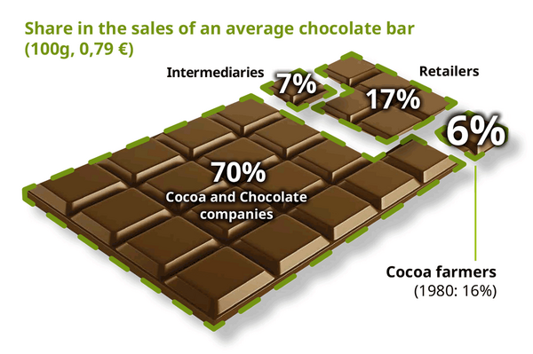
The Value Chain: how much value is added from raw material suppliers to retail purchase price?

Slide 5
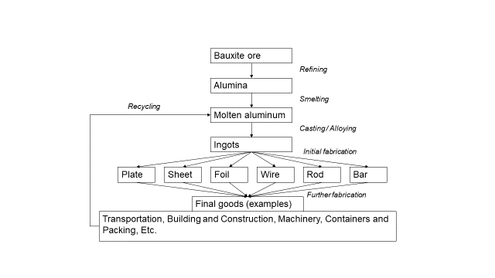
Vertical chain of production (again)
Aluminum in Kentucky?? https://www.lanereport.com/102908/2018/07/aluminum-light-strong-job-creator/?utm_source=Faster%20Lane%20Newsletter&utm_medium=Email&utm_campaign=
Upstream? Downstream?

Slide 6
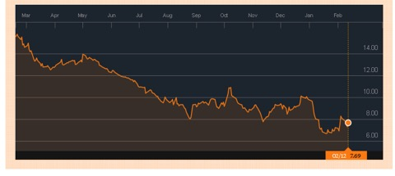
From February 2016: “In September last year Alcoa Inc, a global leading aluminium producer by revenue, announced that it would split into two separate companies. One company will retain the Alcoa name and primary aluminium business while the other, yet to be named (Arconic), will house Alcoa’s value-added business. Alcoa’s CEO hopes that the move will unlock shareholder value and will result in a generally positive outcome for the company as a whole.” http://aluminiuminsider.com/alcoas-split-a-smart-move-2/

Slide 9
Make or Buy?
Firms use raw materials, machinery and equipment, energy, human resources, intermediate goods, etc. etc. in their production processes.
How to acquire such inputs? Two alternatives are to make or to buy.
Make refers to bringing the supply of the input under the scope of the firm’s activities, i.e. make it yourself.
Buy refers to acquiring the input by purchasing it from other firms via market transactions.
The two extreme cases between two stages in the vertical chain of production are thus complete vertical integration and arm’s length spot market transactions. There are, however, intermediate degrees of connection between upstream and downstream:

Slide 10
Make-or-Buy Continuum
Arm’s length market transactions | Long-term contracts | Strategic alliances and joint ventures | Parent / subsidiary relationships | Perform activity internally
Less integrated |  | → → → |  | More integrated
Buy |  | → → → |  | Make

Slide 11
Transactions Costs
Transactions costs are an important factor in the firm’s make or buy decision.
Any market exchange involves costs of acquiring information, negotiating, specifying the terms of the exchange, inspection, monitoring, enforcement, and warranty.
Sometimes it is less costly to subsume a particular productive activity within the umbrella of a firm and avoid the costs of a market transaction.
Sometimes it is not.
Examples: buying a gallon of milk at Kroger’s, buying a new Camry from your Toyota dealer, buying rolled steel for TMMK.

Slide 12
Advantages of using the market: Economies of Scale
Sometimes there are scale economies in producing an input that would not be exhausted by the firm’s usage of the input.
Toyota’s problem: make its own tires or purchase them from third-party suppliers?
Until now, the only way out of this dilemma has been to aim to become the lowest cost producer in the industry. The solution was seen to be the establishment of large operations taking advantage of economies of scale. Goodyear's Lawton plant has a capacity of 20 million tyres per year and in Korea, Kumho has built a plant at Kwangju with a capacity of 18 million tyres whilst Hankook has gone even bigger with its Daejon plant capable of 23 million tyres annually. http://www.just-auto.com/analysis/manufacturing-trends_id86745.aspx
TORRANCE, Calif. (Jan. 5, 2016) – Toyota Motor Sales (TMS), U.S.A., Inc., today reported December 2015 sales of 238,350, an increase of 10.8 percent from December 2014 on a volume basis. With two additional selling days in December of 2015, sales were up 2.9 percent on a daily selling rate (DSR) basis. For the year TMS reported sales of 2,499,313 units, a 5.3 percent increase.

Slide 13
Toyota’s acquisition of tires
C’
Average cost
C*
LRAC
10m
MES
Quantity of tires

Slide 14
Advantages of using the market: Aggregating Uncorrelated Demands
Markets can aggregate uncorrelated demands, and thereby take advantage of risk-pooling benefits.
Suppose you are a general construction contractor, and are building a new business school at the U of KY. At several points along the way during the project, you need construction crane services. Do you own and operate your own cranes or purchase in the marketplace?
http://www.barnhartcrane.com/markets/heavy-lift-cranes/

Slide 15
Advantages of using the market: Economies of Scope
Sometimes there are economies of scope in producing a set of inputs that would not be exploited by the firm’s usage of just one of this set of inputs.
Toyota’s problem: make its own audio equipment or purchase auto audio equipment from third-party suppliers?
http://www.jbl.com/automotive-toyota.html
Economies of scope? http://www.jbl.com/

Slide 16
Advantages of using the market: Providing Discipline
One final, and perhaps most important, advantage of market acquisition is that markets impose discipline that a firm must replicate with some sort of administrative structure if it chooses to vertically integrate to acquire a particular input.
Suppose Toyota decides to vertically integrate and start making rather than buying tires. Can you see any potential problems with locking into supplying your own tires to your auto manufacturing plants?
http://www.cnn.com/2012/07/26/travel/tire-recall/index.html
https://www.wsws.org/en/articles/2011/12/coop-d14.html
http://www.truckinginfo.com/article/story/2013/05/the-high-cost-of-tires.aspx
If one of your current tire suppliers tells you about their various problems and wants to raise their prices, what options do you have that you do not if you manufacture your own tires in-house?

Slide 17
Reasons for vertical integration: production efficiencies
In some production processes, there are physical production efficiencies that make cheek-to-jowl production (with accompanying joint ownership) more efficient.
Example: molten aluminum and downstream fabrication. Heat; then let cool; transport; heat again and fabricate; then cool again??
Or just heat it once?
http://www.lanereport.com/82951/2017/10/logan-aluminum-cuts-ribbon-on-407-6m-expansion-breaks-ground-on-phase-ii/?utm_source=Faster%20Lane%20Newsletter&utm_medium=Email&utm_campaign=

Slide 18
Reasons for vertical integration: extensive coordination
Chicken processing plants: Powered by rapid consumption growth, chicken slaughter grew by 4% per year between 1967 and 1992 while turkey slaughter grew 3.7% annually. Nevertheless, the number of turkey plants fell by 60%, while there were only a few more chicken plants in 1992 than there were in 1967. For that to happen, plants had to get much bigger: mean plant size in turkey slaughter increased more than sixfold, while the mean size of chicken plants almost tripled. . . . Organizationally, most poultry slaughter firms adopted an integrated structure in which the integrator, such as Tyson Foods or Perdue, owns the slaughter plant, feed mill, and further processing plants and contracts with a number of poultry growers. The integrator provides the grower with chicks or poults, feed, veterinary services, and other inputs. The grower contributes housing and labor services for raising birds to finished size. Growers frequently maintain long-term relationships with processors—Perry, Banker, and Morehart report that their sample of growers had been with the same processor for nine years, on average. [Amer. J. Agr. Econ. 87(1) (February 2005): 116–129]
Vertical connection between growers and processors: long-term contracts http://millerpoultry.com/potential-grower-information/
Contract cattle farming? Poultry and pork operations have grown larger in recent decades to take advantage of lower costs that come with economies of scale. However, the beef business continues to have legions of small operators --- some with fewer than 30 head of cattle --- because the animals require large plots of land for foraging. It's harder to consolidate and manage smaller, more diverse cattle farms and growing operations, so vertical integration isn't practical among beef producers. http://smallbusiness.chron.com/vertical-integration-beef-industry-14614.html
https://www.youtube.com/watch?v=LWxjY-yDAn8

Slide 19
Reasons for vertical integration: information asymmetries
If the upstream supplier of an input has more information about the quality of an input than the downstream buyer who uses the input in its production process, the buyer is susceptible to exploitation. The input supplier may exploit the buyer by supplying a lower quality product than the buyer was expecting. Vertical integration is one way to eliminate the incentive of the upstream seller to chisel on quality.
Example: Gready Foundries and Matsushita. Matsushita contracted with Gready to cast the steel blocks used in its automotive air conditioner compressors. Matsushita then machined and assembled these air conditioner units and supplied them to Toyota, Honda, Mazda, etc. Matsushita guaranteed its compressors for a decade or more. Challenge: How could Matsushita know whether Gready was supplying cast steel blocks that met its very high metallurgical quality standards?
Solution: Matsushita paid for Gready to build an extra electric furnace dedicated solely to its compressors, and kept a supervisor on site to oversee the operation. https://www.youtube.com/watch?v=mYWWregndoY

Slide 20
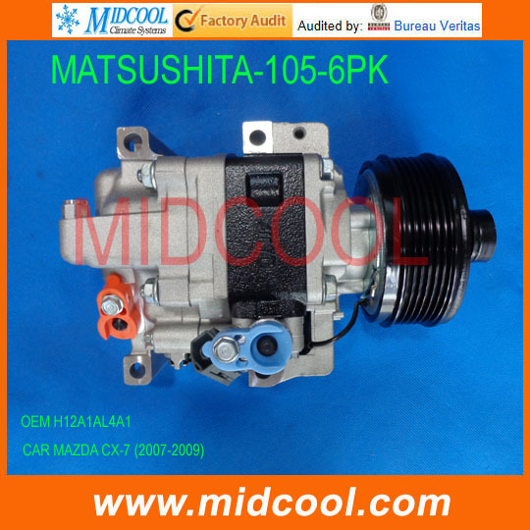

Slide 21
Reasons for vertical integration: reputation externalities
Some products involve centralized development of a process, business format, or product, and development and maintenance of the associated brand-name capital. Production and delivery of the product to customers will be decentralized if customers are spread through geographic space.
The value of the brand name will depend on customers’ perception of the quality of their consumption experience. If customers who have a bad experience at one location associate bad quality with the entire chain, there are what we call reputation externalities.
Example: you are driving across country, in areas where you have never been. You are hungry and pull off the highway to get a bite to eat. You have two choices, Hardee’s and the Blue Ridge Cafe. Which do you choose? http://www.blueridgecafefloyd.com/
Challenge for the owner of the brand name: how to prevent its decentralized suppliers from chiseling on quality at their location and free-riding on the reputation established by everyone else in the chain.
Solutions? Vertical integration? Franchising?

Slide 22
Reasons for vertical integration: specialized assets
Specialized assets: refer to inputs that have significant productivity in a particular use, but little or no value outside of that use.
The investment in that asset, once undertaken, is irreversible and so the cost is a sunk cost.
Sidebar: are sunk costs relevant for current production decisions? https://www.youtube.com/watch?v=5JkaZBYdOSs
The problem with specialized assets is that the owner of the specialized asset is subject to hold-up, and hence will be reluctant to make the investment in the first place.
One solution is vertical integration.

Slide 23
Types of asset specificity
Site specificity: mine-mouth power plant http://trib.com/business/energy/mine-mouth-coal-power-plants-a-trade-off-between-distribution/article_83f38a42-51ab-51ce-9e11-9de4183a5a07.html
Physical asset specificity: the doughnut machine https://www.youtube.com/watch?v=Qu0ISv_GeHI
Human asset specificity: Gatton’s MBA training program vs. UK’s employee training programs. Which of these would you be willing to pay for yourself?
http://gatton.uky.edu/programs/mba/one-year-accelerated-mba
http://www.uky.edu/hr/training/offerings/uk-business-procedures-certification-series
Dedicated assets: Hopple Plastics and Boston Market plates; TVA, Peabody Coal Co., and “Big Hog” http://www.rockportky.com/CoalMines/SinclairMine/SinclairMine.html
For the musical version of the story: https://www.youtube.com/watch?v=DEy6EuZp9IY

Slide 24
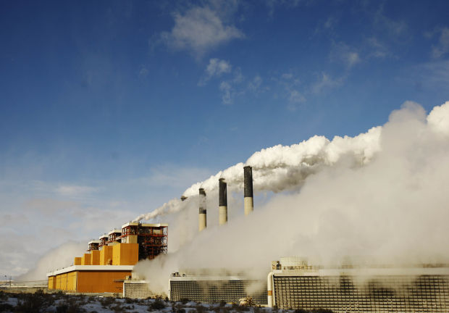

Slide 25
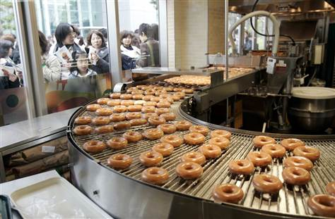

Slide 26
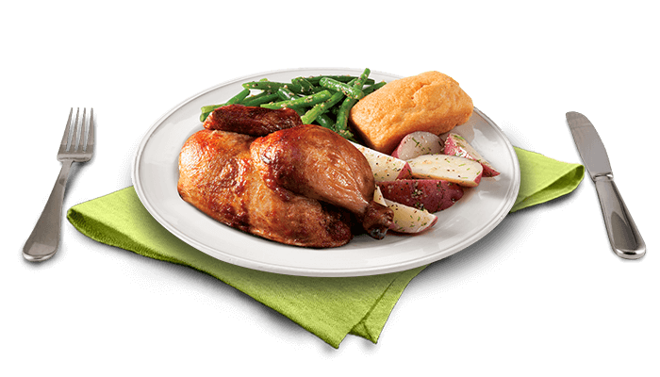

Slide 27
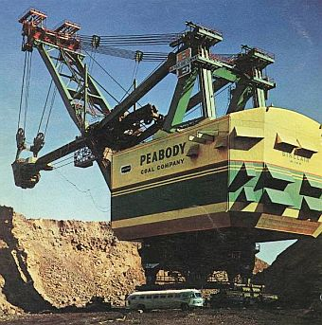

Slide 28
Specialized assets and the Hold-up problem
KU/LG&E and coal deposit in eastern Kentucky:
One option is to build a power plant on Ohio River where coal sells for $30/ton.
Second option is to build a power plant right beside an undeveloped coal deposit deep in the mountains.
Coal mine could be developed to produce coal for $20/ton for the expected life of the power plant, where $10/ton would be up-front irreversible investment to develop the site and open the mine, and $10/ton would be the ongoing variable costs of operating the mine.
Cost of shipping coal into or out of the mountains where the power plant and coal mine are located equals $20/ton.
Cost of shipping electricity out of the mountains is essentially zero.

Slide 29
Stick ‘em up!
Is it economical to develop the coal mine and ship coal to the Ohio River where it can be sold in a thick market at $30/ton?
Not if it costs $20/ton to ship it out of the mountains.
Is it economical to develop the coal mine if, at the same time, KU/LG&E builds the power plant, using your coal to generate electricity at this location?
Yes, at any price between $20 and $30 per ton for the coal.
Are either the power plant owner or the coal mine owner vulnerable to hold-up?
Suppose you make the irreversible up-front investment and develop your coal mine, and at the same time KU/LG&E builds a power plant alongside. After a year of selling coal to them at $25/ton, they approach you and tell you they aren’t willing to pay anything more than $15/ton going forward.
What is your response?
What does this possibility do to your willingness to make a significant up-front irreversible investment to open the mine?
Can you think of a solution?

