Slide 1
ECO 610: Lecture 8
Monopoly and Pricing with Market Power

Slide 2
Monopoly and Pricing with Market Power: Outline
Goal: understanding the exercise of market power in monopoly markets
Definition of monopoly and examples
Short-run profit maximization of a monopolist
Monopoly power—long run economic profits and the importance of entry barriers
Monopolistic competition: Monopoly? Competition? Elements of both?
Pricing with market power: inverse-elasticity rule and types of price discrimination

Slide 3
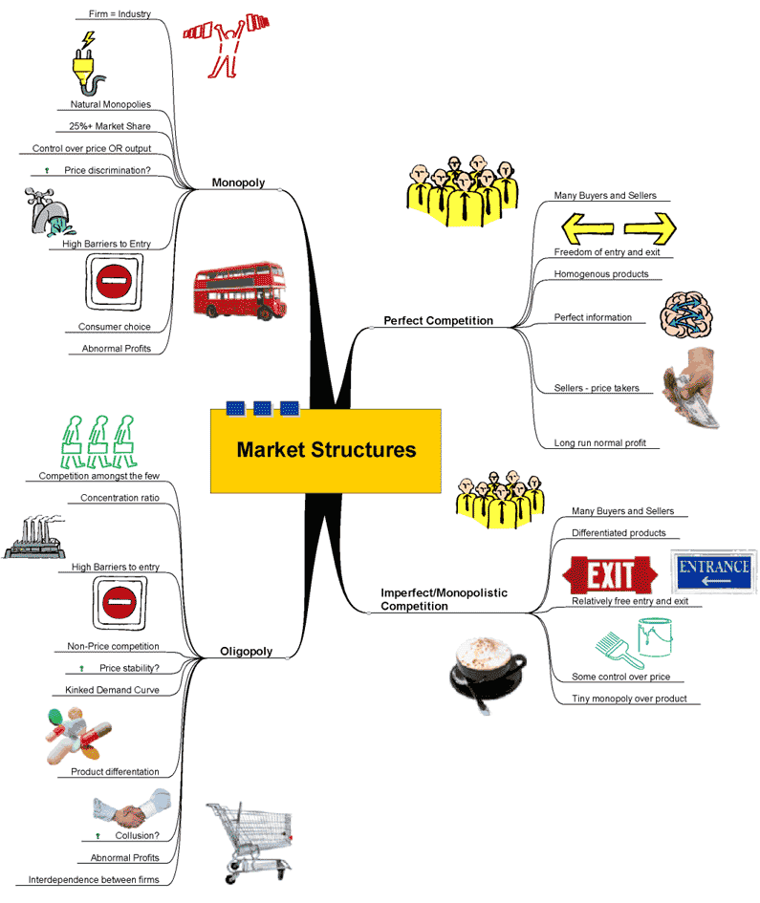
A taxonomy of market structures

Slide 4
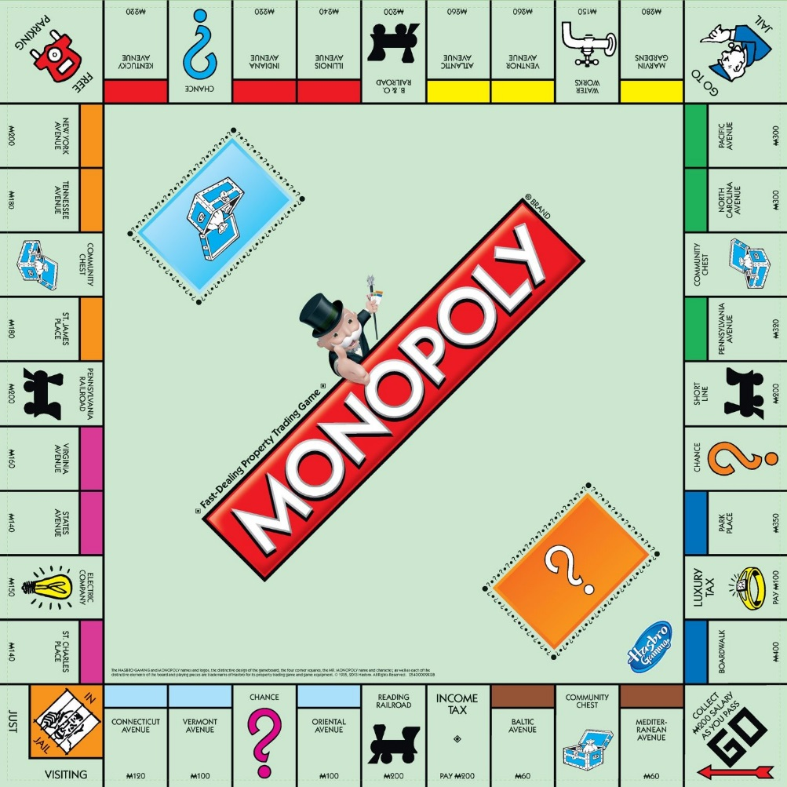
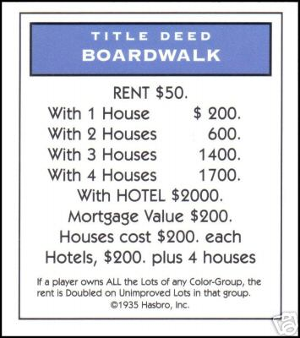
Definition of Monopoly
Monopoly: the only producer of a product for which there are no close substitutes
Examples?

Slide 5
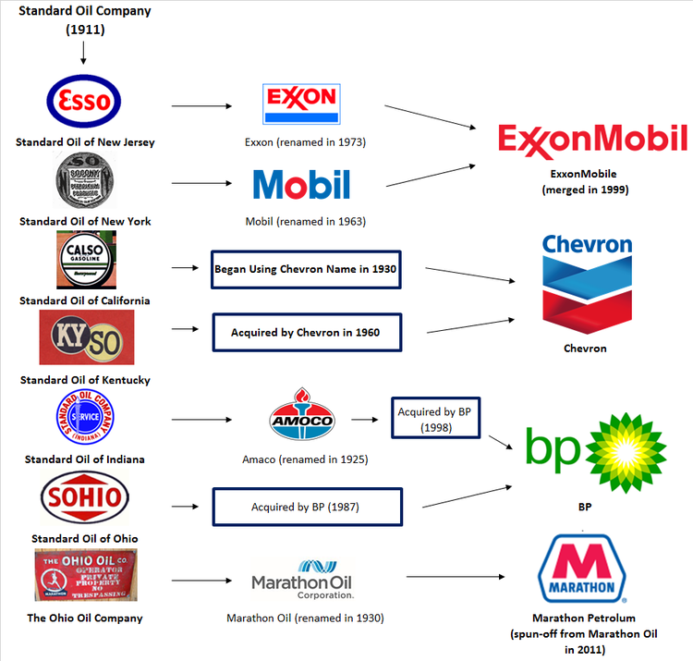
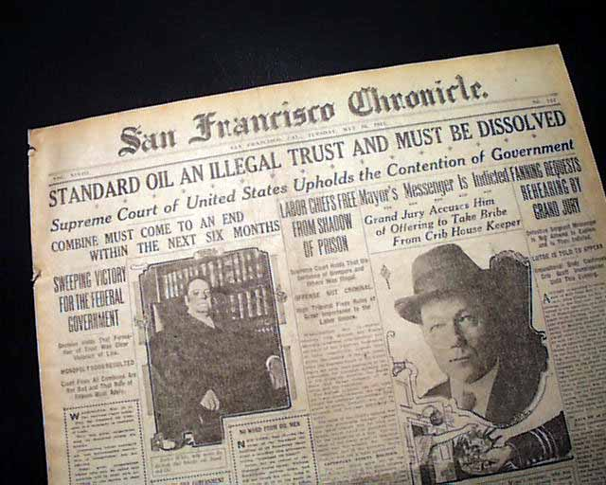

Slide 6


Slide 7



Slide 8
“for which there are no close substitutes”???
Cable TV monopoly? https://www.metronetinc.com/
Google’s market dominance? https://www.bing.com/
Mickey Mouse? https://disneyworld.disney.go.com/
Cancer treatment? https://www.ibrance.com/
The Parthenon?

Slide 9
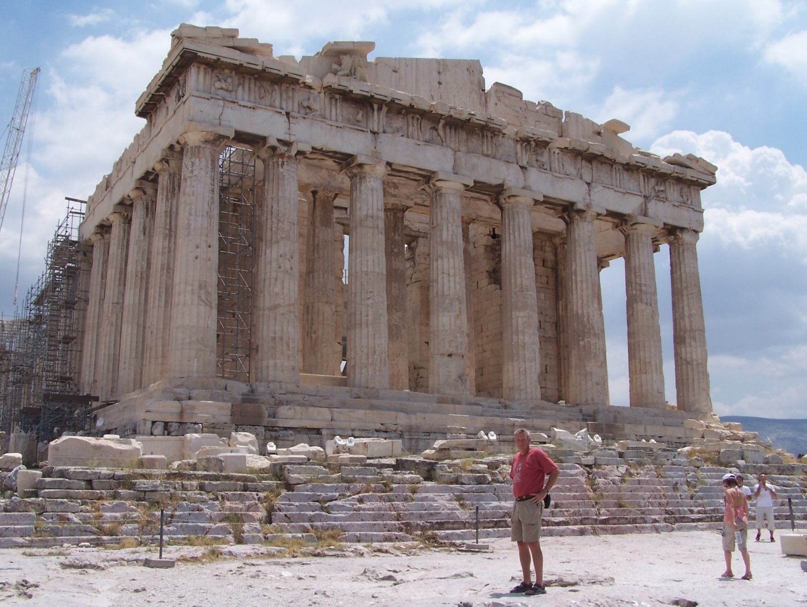
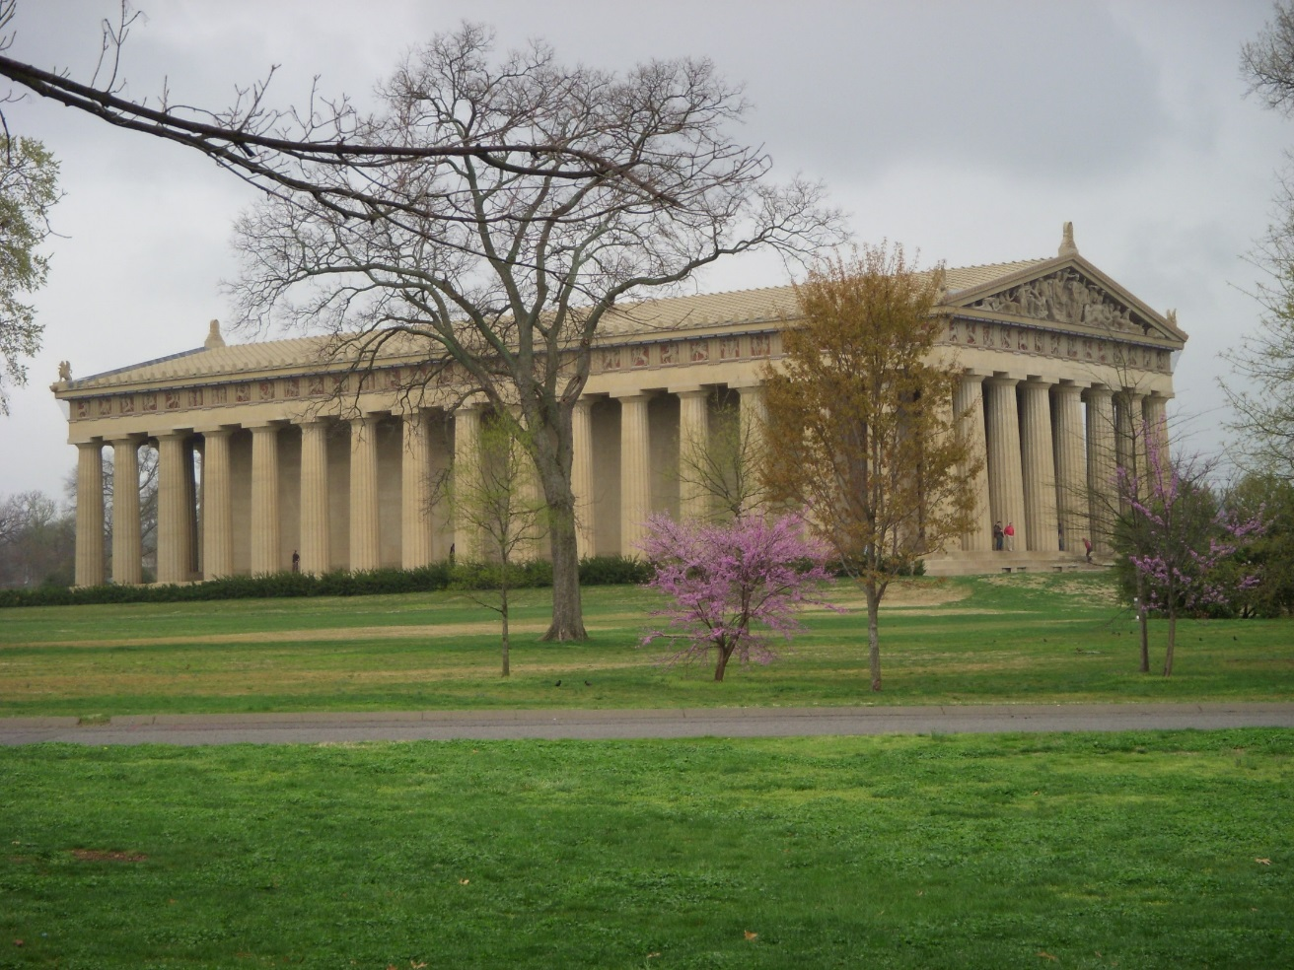

Slide 10
Demand curve facing a monopolist
Supply side of a competitive market: many small independent firms
Supply side of a monopoly market: one firm
Demand curve facing a competitive firm: perfectly elastic at the market price
Demand curve facing a monopolist: Market demand, since the supply side of the market consists of one firm—the monopolist
[refer to diagram on board—demand for Parthenon visits]
Result is that in order to sell more of the product a monopoly must reduce its price, so it is a price searcher—it must determine which price and output combination maximize profit.

Slide 11
What P and Q will maximize profit?
P | Q | TR | MR
500 | 50 | 25000 | 500
200 | 500 | 100000 | 167
100 | 1500 | 150000 | 50
50 | 4000 | 200000 | 20
20 | 8000 | 160000 | -10
10 | 12000 | 120000 | -10
(Imaginary numbers made up by your professor)

Slide 12

What output will maximize profit in the short run for the only miniature golf course in town?
First decision: produce Q = 0 or produce Q > 0 in the short run?
What does producing Q = 0 in
the short run [i.e. shut down] look like?
How to decide whether to shut down
or produce a positive output?
π = TR – TC = TR – TVC – TFC
If Q = 0, then TR = 0 and TVC = 0, so
π = - TFC; i.e. your losses equal your fixed costs
If Q > 0, then π = TR – TVC – TFC
So, if [TR – TVC] > 0, you are better off producing Q > 0. If TR < TVC, you are better off shutting down in the short run.
Alternatively, if TR/Q < TVC/Q , i.e. if P < AVC, then shut down in the short run.

Slide 13
If P > AVC, what output will maximize profit in the short run for the only miniature golf course in town?
If P > min AVC such that producing a Q > 0 is optimal, what Q will maximize profit for the monopolist in the short run?
Expand output as long as producing and selling another unit adds more to total revenue than it does to total cost.
In other words, expand output up to point where MR = MC.
Important concept: Marginal Revenue is the change in total revenue that occurs when the firm produces and sells another unit of output.
What is marginal revenue for a monopolist? MR = ΔTR/ΔQ .
As the firm expands output, does it have to lower price to sell more output? Yes, since the market demand curve is the firm’s demand curve.

Slide 14
Demand, total revenue, and marginal revenue
Price | Quantity | Total Revenue | Marginal Revenue
$5.00 | 0 | 0
 |  |  | $4
$4.00 | 1 | $4
 |  |  | $2
$3.00 | 2 | $6
 |  |  | $0
$2.00 | 3 | $6
 |  |  | ($2)
$1.00 | 4 | $4
 |  |  | ($4)
$0.00 | 5 | $0
(Refer to diagram on board)

Slide 15
A simple example of profit maximization for a monopoly
Figure #1 (drawn on board): Total revenue, total cost, profit.
Figure #2 (drawn on board): Demand, marginal revenue, marginal cost, profit-maximizing price and output, profit.

Slide 16
Total Revenue, Total Cost, Profit
$
Total Revenue
Total Cost
Profit
Q

Slide 17
Figure 2: Demand, Marginal Revenue, and Marginal Cost
D
MC
Quantity
MR

Slide 18
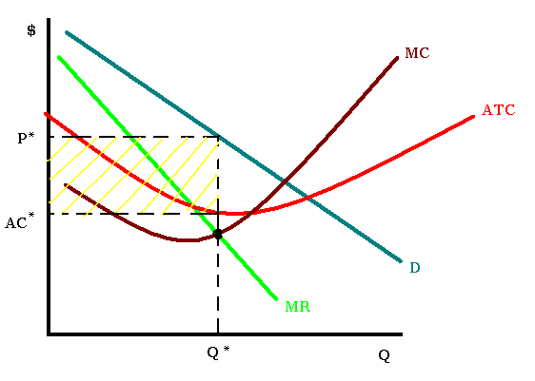
A monopolist earning positive short-run economic profits:

Slide 19
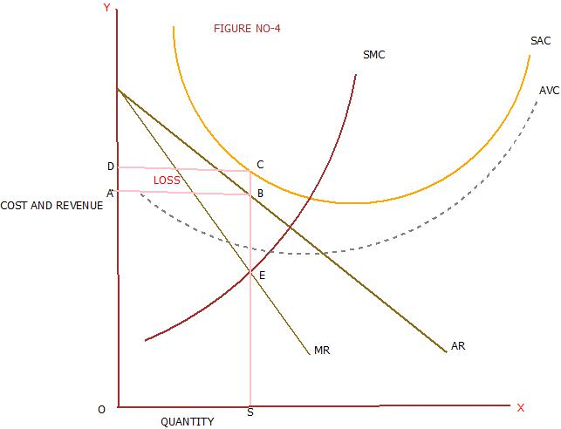
Long-run adjustments in monopoly markets
In the short run, a monopolist may make positive, zero, or negative economic profits.
What sort of adjustments do you
expect to occur over time if
the monopolist is suffering
short-run economic losses?
Enjoying short-run economic
profits?

Slide 20
Barriers to Entry and Monopoly Power
In a competitive market, when existing sellers are earning an above-normal return, we predict that new firms will enter the market and compete away those profits.
If a monopolist is earning short-run economic profits, will entry occur and the monopolist’s profits disappear?
Not if there are significant barriers to entry.
Monopoly Power: the ability of a firm to earn positive long-run economic profits
Only if there are barriers to entry can a firm expect to earn an above-normal return that persists over time.

Slide 21
Sources of entry barriers
Ownership of an essential resource or raw material
  Examples? Parthenon. DeBeers.
Economies of scale
  Examples? Railroad. Ice-skating rinks in Lexington.
Legal barriers
  Examples? Patented drugs. Local moving companies in Lexington.
Strategic entry deterring behavior by incumbent firms
  More on this when we study oligopoly and game theory.

Slide 22
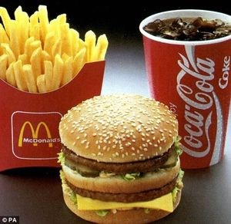
Monopolistic Competition
How would you characterize MacDonald’s and its signature product, the Big Mac?
Monopoly? Perfectly competitive? A blend of the two?
MacDonald’s has a monopoly on Big Macs. But there are many substitutes for Big Macs, so MacDonald’s monopoly is a bit different from DeBeers.

Slide 23
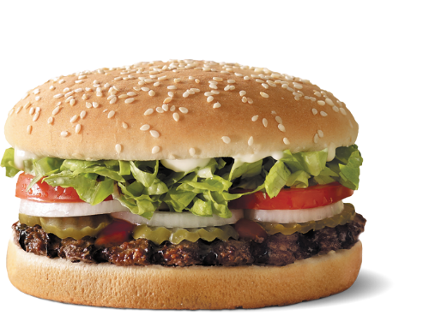
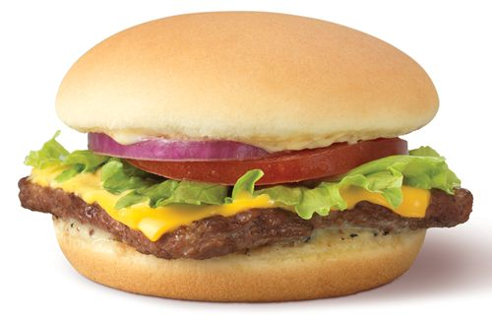
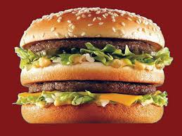
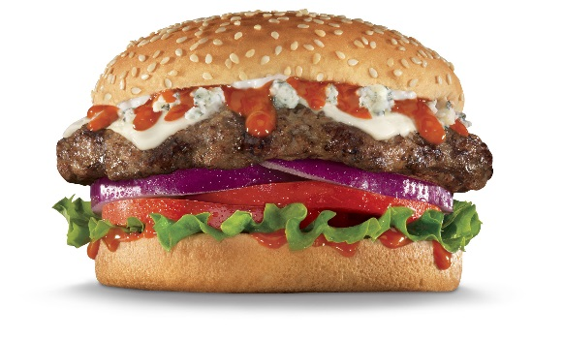
Characteristics of monopolistic competition
Many small independent sellers
Many small independent buyers
Differentiated product
Insignificant entry barriers
Examples? http://www.lexingtonburgerweek.com/#!burgers/cfvg

Slide 24
Short-run profit maximization by a monopolistically competitive firm
Firm’s demand curve is downward sloping, because other attributes of the product besides price matter to consumers.
Firm must lower price to sell more of the product.
Customer responsiveness to changes in price (own price elasticity of demand) depends on “closeness” of substitutes.
Shut down decision?
How much to produce? What price to charge?
Short-run economic profits? Losses?
[refer to diagram drawn on board]

Slide 25
Long-run adjustments in a monopolistically competitive market
Suppose firms in the industry are earning positive economic profits.
What changes do you predict, given enough time for firms to adjust?
  Entry of new competitors.
How will that affect existing producers?
  Fewer customers. Incumbent producers will see their demand curves shift inward.
Where does it end? When is the market in long-run equilibrium?
  Zero economic profits. When enough new competitors have entered the market such that sellers are earning a normal return, there is no incentive for additional entry.

Slide 26
A Monopolistically Competitive
Firm in the Short and Long Run
$/Q
Short Run
$/Q
Long Run
MC
MC
AC
AC
P_{SR}
P_{LR}
D_{SR}
D_{LR}
MR_{SR}
MR_{LR}
Q_{SR}
Quantity
Q_{LR}
Quantity
Notes:
12

Slide 27
Pricing with Market Power
Market Power refers to the ability of a firm to set its own price, as opposed to firms that are price takers and take market price as given.
Challenge for a firm with market power: how to set price so as to extract maximum surplus from its customers.
The simplest pricing strategy is to charge all customers the same uniform price per unit.
Under certain circumstances, firms can increase their profits by adopting more complex pricing strategies.

Slide 28
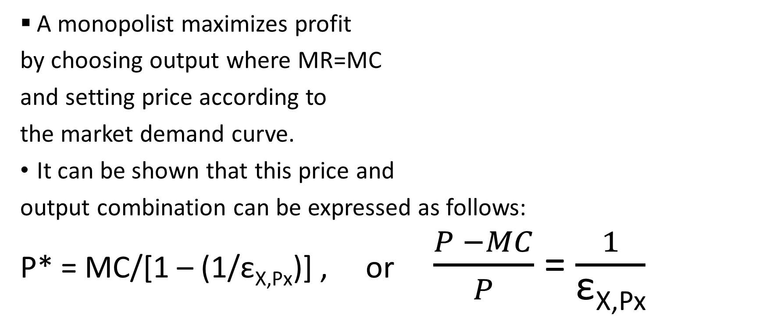
The inverse-elasticity pricing rule
A monopolist maximizes profit
by choosing output where MR=MC
and setting price according to
the market demand curve.
It can be shown that this price and
output combination can be expressed as follows:
P* = MC/[1 – (1/ε_{X,Px})] , or $\frac{P −MC}{P}$= $\frac{1}{\text{ε}\text{X}\text{,}\text{Px}}$

Slide 29
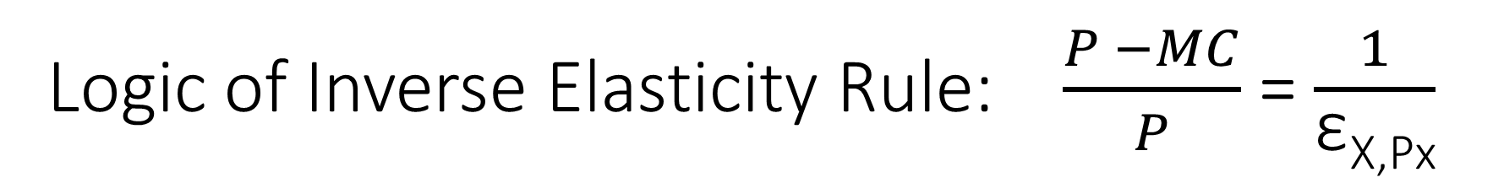
Logic of Inverse Elasticity Rule: $\frac{P −MC}{P}$= $\frac{1}{\text{ε}\text{X}\text{,}\text{Px}}$
The IER suggests that in order to maximize profit, a monopolist should set price such that the markup of price over marginal cost is inversely related to own-price elasticity of demand.
Optimal gouging: the less elastic is demand, the bigger or smaller the markup of price over marginal cost???
Examples? Airline pricing policies? Student and senior citizen discounts? Industrial parts? http://ezproxy.uky.edu/login?url=http://search.proquest.com/docview/399036795?accountid=11836

Slide 31
Potential for higher profit
A monopolist setting a uniform price for all customers may be able to earn positive long-run economic profits, if barriers to entry protect it from new competitors.
Under certain circumstances the monopolist may be able to employ more complex pricing strategies that allow it to increase its profits.
Simple example: backyard roller coaster. Demand curve for typical customer:
Uniform pricing strategy:
P*=$3, Q=2, π=$4
D
MC
MR

Slide 32
Creative pricing strategies?
Does a uniform price extract the maximum consumer’s surplus available in this market? i.e. can you come up with a more complex pricing strategy that increases your profits?
[Refer to diagram drawn on board]
How do King’s Island, Disney World, Kentucky Kingdom, and other amusement parks price their product?
Two-part pricing. Set a price per ride and charge an admission fee as well.
How should you set the price per ride? Admission fee?

Slide 33
Price Discrimination
Price Discrimination occurs when a firm charges:
Different prices to different customers for the same good
Different prices to the same customer for successive units of the good
The same price to different customers for different (in terms of cost) goods
Examples?
  http://ezproxy.uky.edu/login?url=http://search.proquest.com/docview/1030070943/138B00F13ED129D5D44/87?accountid=11836
  http://search.proquest.com.ezproxy.uky.edu/docview/1640656018/282BDA0784EC4495PQ/60?accountid=11836
  http://ezproxy.uky.edu/login?url=http://search.proquest.com/docview/1416012158/13FC4793A95703AF36B/87?accountid=11836

Slide 34
Necessary conditions for price discrimination
The following conditions are necessary in order for a firm to be able to price discriminate:
The firm must face a downward-sloping demand curve, i.e. it must have market power.
The firm must have the ability to identify and sort customers according to their willingness to pay.
The firm must be able to prevent arbitrage, i.e. resale of the commodity.
How do airlines sort customers into WTP categories? Why doesn’t the university bookstore charge out-of-state students higher prices for their textbooks than in-state students?

Slide 35
First-degree price discrimination
First-degree price discrimination is perfect price discrimination. The seller extracts all surplus from consumers.
First-degree price discrimination can be accomplished by walking down the demand curve—individually negotiating with each customer and charging the highest price they will pay.
[Dry Ridge Toyota example, diagram drawn on board]
It can also be accomplished with a two-part price—an entry fee plus a price per unit, where the entry fee is set so as to extract all surplus.
[amusement park example, diagram drawn on board]

Slide 36
Second-degree price discrimination
Second-degree price discrimination involves the use of self-selecting quantity discounts.
Example: suppose you operate a cell-phone company and face two categories of customers. [illustrated on the board]
Simple pricing strategy: charge 7¢ per minute to one and all. Type 1 and type 2 customers will choose 120 minutes each and TR = $16.80
Can you increase your revenues by changing your pricing strategy?
More complex pricing strategy: offer self-selecting quantity discount whereby Plan A has 100 minutes per month for $10 and Plan B has 300 minutes per month for $15. With these options, type 1 customers will choose Plan A and type 2 customers will choose Plan B. Total revenue will be $25.

Slide 37
Third-degree price discrimination
Third-degree price discrimination involves market segmentation, whereby the firm is able to set different prices in each market segment. Inverse-elasticity pricing rule is the order of the day.
Example: airline pricing. Suppose you have two types of travelers, leisure and business. Business travelers are relatively unresponsive to changes in price, while leisure travelers are relatively responsive to changes in price. [illustrated on board]
How to set price for each type of customer? Choose Q and P such that MR = MC in each market segment.
Challenge: How to identify and sort customers?

Slide 38
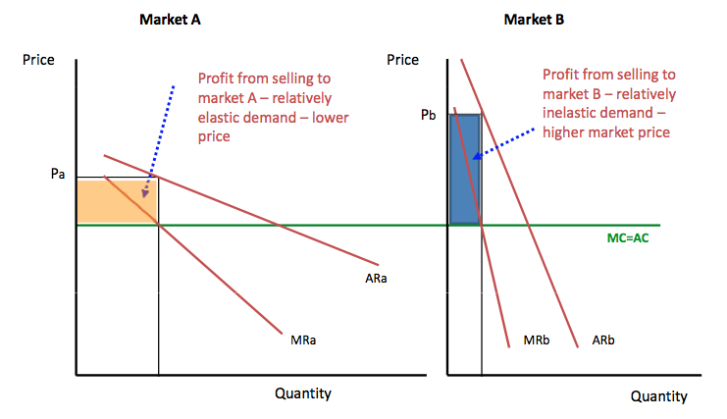

Slide 39

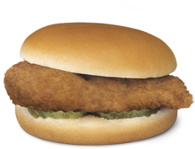

Commodity Bundling
Suppose that a firm sells multiple products, and that different customers have different reservation prices for each good.
Example: Toyota sells Camrys, which can be purchased in the L, LE, or XSE versions https://www.toyota.com/camry/2019/features/mpg/2550/2514/2532
Different pricing strategies:
  Pure components strategy: offer a la carte prices for each separate item.
  Pure bundling strategy: bundle the two items and charge one price for the bundle. https://www.youtube.com/watch?v=hdIXrF34Bz0
  Mixed bundling strategy: offer and price the two items separately, and also offer and price them together as a bundle.
Bundling can be more profitable if it allows the firm to sort customers into groups with different reservation price characteristics and hence to extract consumer’s surplus. For a deeper analysis, see https://www.youtube.com/watch?v=8mw5RLzWNnE

Slide 40
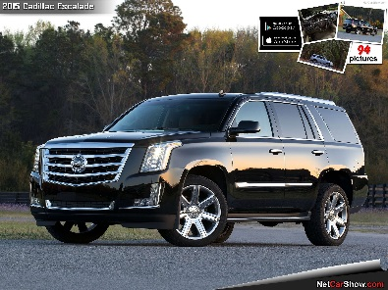

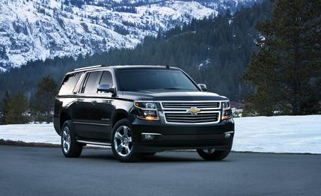
Other pricing issues: multiple products that are related in demand
Demand Interrelationships: suppose a firm produces two products, A and B, that are related in demand but unrelated in cost.
      π = TR_{A}(Q_{A}, Q_{B}) + TR_{B}(Q_{A}, Q_{B}) - TC_{A}(Q_{A}) - TC_{B}(Q_{B})
Suppose A and B are unrelated, how to set price?
  No differently than two separate single-product monopolists would.
Suppose A and B are substitutes, how to set price?
  Set prices higher than if A and B were unrelated (cannibalization).
Suppose A and B are complements, how to set price?
  Set prices lower than if A and B were unrelated.

