Slide 1
ECO 610: Lecture 7
Perfectly Competitive Markets

Slide 2
Perfectly Competitive Markets: Outline
Goal: understanding firm and market supply in competitive markets
Characteristics of perfectly competitive industries
Short-run production decision of a perfectly competitive firm
Short-run market supply and equilibrium in a perfectly competitive market
Long-run adjustments and equilibrium in a perfectly competitive market

Slide 3
A taxonomy of market structures

Slide 4
Characteristics of a perfectly competitive market
Large number of small, independent sellers
Large number of small, independent buyers
Homogeneous product
Insignificant barriers to entry and exit
Perfect information available to buyers and sellers
Examples? Alligator farming?

Slide 5
Can you really farm these things?

Slide 6
Short-run production decision of a perfectly competitive firm
Imagine that you are a commodity market analyst for a major fashion house: http://search.proquest.com.ezproxy.uky.edu/docview/399057549?accountid=11836
The CEO comes to you and asks where you think alligator skin prices are going, because she wants to add a line of alligator handbags, luggage, and cowboy boots. https://vintageskins.com/new-cognac-ralph-lauren-alligator-belly-skin-ricky-bag-sac-mallette-handbag-tags/
You say let me do some research and get back to you on that.
What analytical framework do you use to figure out what is going on now in the alligator market and where things are headed?

Slide 7
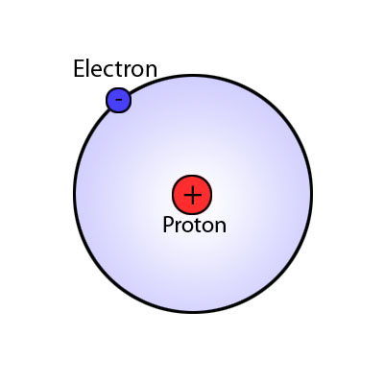
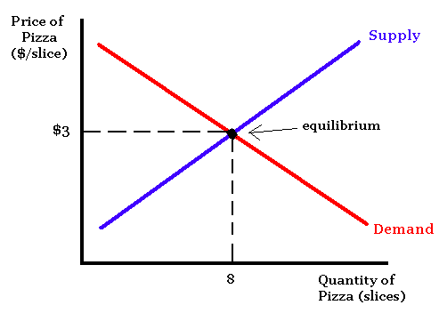
The usefulness of abstract models

Slide 8
Modeling the firm’s supply decision
To understand how price and output get determined in both the short run and long run in a competitive industry, let’s ask and answer a series of questions:
How is the price of alligators determined?
What does the demand curve facing each individual alligator farmer look like?
What output will maximize profit for the farmer in the short run?
What happens to the farmer’s optimal output as market price changes?
What does the farmer’s short-run supply curve look like?
What does the short-run market supply curve for alligators look like, given information on individual farmers’ supply curves?

Slide 9
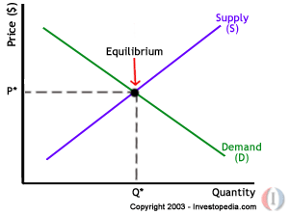
How is the price of alligators determined?
Market demand and supply. Market demand represents the collective decisions of all alligator buyers. We are building towards understanding how market supply is determined.
What is P* in 1989 in the market for alligators? http://ezproxy.uky.edu/login?url=http://search.proquest.com/docview/398158016?accountid=11836

Slide 10
What does the demand curve facing each individual alligator farmer look like?
If each producer is small relative to the market, what impact will any one producer’s output decision have on market price?
What is the relevant range of output for an individual alligator farmer?
What is industry output?
What happens to market price if an individual alligator farmer withholds all his gators from the market in a given year?
What happens to market price if that farmer produces and sells as many as he can in a given year?
We say that a firm in a perfectly competitive industry is a Price Taker, because the firm’s demand curve is perfectly elastic at the market price.

Slide 11
Demand Curve of a Perfectly Competitive Firm
Price
$ per
4-foot
gator
Price
$ per
4-foot
gator
S
Firm
Market
$180
d
$180
D
1000
2000
q: Output
(4-foot
alligators)
200,000
Q: Output
(4-foot
alligators)
Notes:
27

Slide 12
What output will maximize profit for the firm in the short run? The shutdown rule
First decision: produce q = 0 or produce q > 0 in the short run?
What does producing q = 0 in the short run [i.e. shut down] look like? What does producing q = 0 in the long run [i.e. go out of business] look like?
http://abcnews.go.com/WN/strawberry-farmers-destroy-crops/story?id=10219820
Which costs are relevant for short-run pricing decisions?
http://economicsoftheoffice.com/all/?id=12
How to decide whether to shut down or produce a positive output?
π = TR – TC = TR – TVC – TFC
If q = 0, then TR = 0 and TVC = 0, so π = - TFC; i.e. your losses equal your fixed costs
If q > 0, then π = TR – TVC – TFC
So, if [TR – TVC] > 0, you are better off producing q > 0. If TR < TVC, you are better off shutting down in the short run.
Alternatively, if TR/q < TVC/q , i.e. if P < AVC, then shut down in the short run.

Slide 13
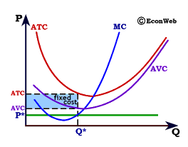

Slide 14
What output will maximize profit for the firm in the short run? Producing a positive rate of output
If P_{Mkt} > min AVC such that producing a q > 0 is optimal, what q will maximize profit for the firm in the short run?
Expand output as long as producing and selling another unit adds more to total revenue than it does to total cost.
In other words, expand output up to point where MR = MC.
[Refer to diagram drawn on board for typical alligator farmer, with AVC and MC diagrams included.]
What is marginal revenue for a perfectly competitive firm? MR = ΔTR/Δq .
As the firm expands output, does it have to lower price to sell more output? No, hence MR = P = d .

Slide 15
What does the firm’s short-run supply curve look like?
As market price varies from zero to $200 per four-foot gator, what output will maximize profits (minimize losses) at each possible price?
[Refer to diagram drawn on board for derivation of competitive firm’s short-run supply curve]
If P_{Mkt} < min AVC, then q* = 0, where q* is the firm’s profit-maximizing output.
If P_{Mkt} > min AVC, then producing q* where P_{Mkt} = MC will maximize short-run profits (minimize short-run losses) for the firm.
Does the firm’s short-run supply curve obey the Law of Supply?
What is the logic of the economic behavior suggested by the firm’s short-run supply curve that we have just derived?

Slide 16
A Firm’s Short-Run Supply Curve
Price
($ per
unit)
S = MC above AVC
MC
P₂
ATC
P₁
AVC
P = AVC
Shut-down
q₁
q₂
Output
Notes:
49

Slide 17
What does the market supply curve look like?
Suppose we have information on the supply behavior of all the producers currently in the market, i.e. we know the individual firms’ supply curves.
How do we derive the market supply curve?
The market supply curve is the aggregation of the supply curves of all firms in the market.
Thus we sum the quantities supplied by all firms at each possible price to get the market supply curve, i.e. we sum the firm supply curves horizontally (since we are aggregating quantities).
[Refer to diagram drawn on board.]
Does the short-run market supply curve for a perfectly competitive industry obey the Law of Supply? Why?

Slide 18
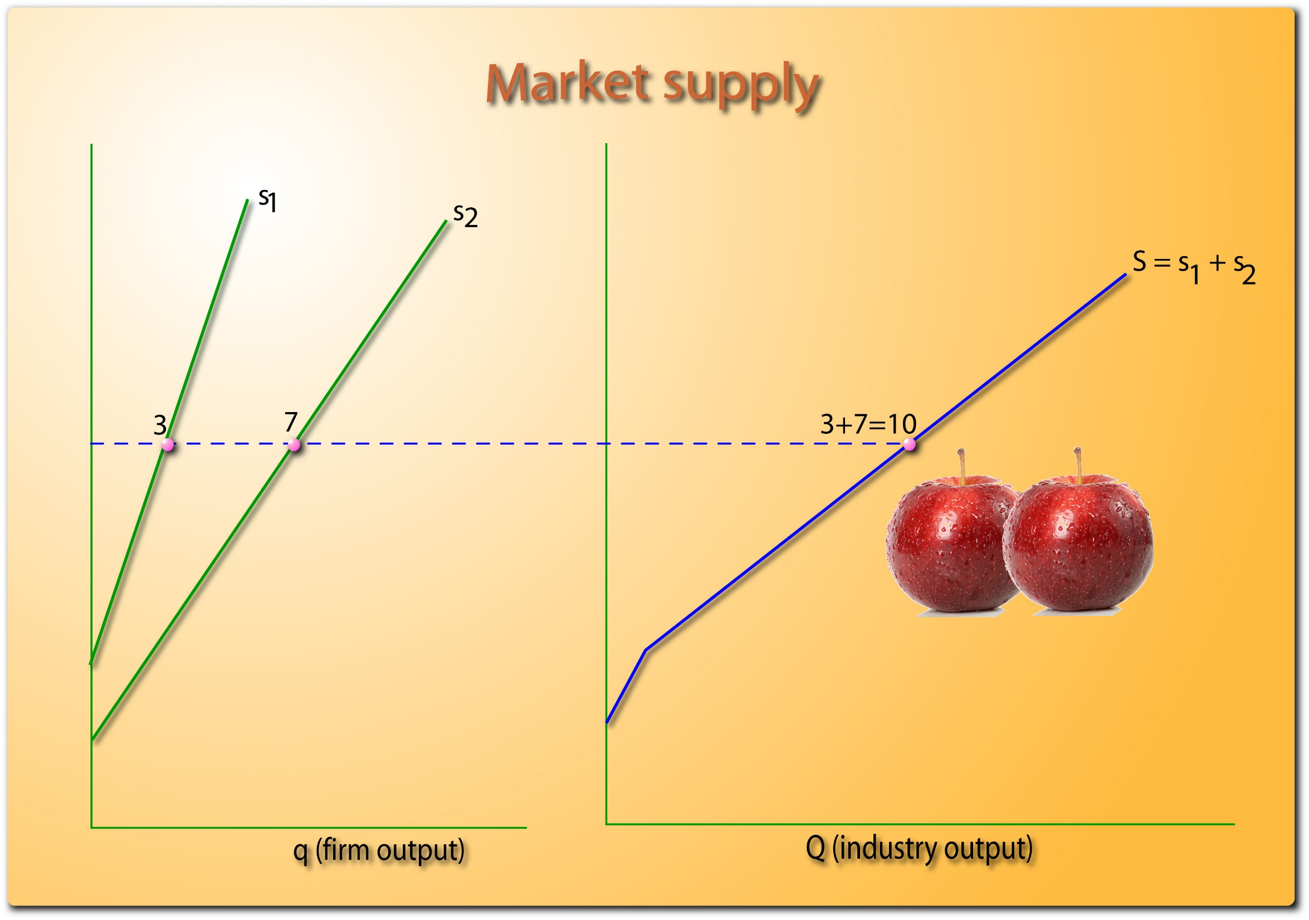

Slide 19
Short-run equilibrium in a perfectly competitive market
A competitive market is in equilibrium in the short run when:
Market price, P*, clears the market, i.e. market quantity demanded equals quantity supplied, i.e. Q_{D} = Q_{S} .
Each firm maximizes profit, producing $q_{i}^{∗}$ where P* = ${mc}_{i}$.
Market quantity supplied equals the aggregation of each firm’s profit maximization decision: Q_{S} = $\sum_{i=1}^{n}{q_{i}^{∗}}$
Do firms make positive, negative, or zero economic profit?
Depends on market price. [refer to diagrams on board]

Slide 20
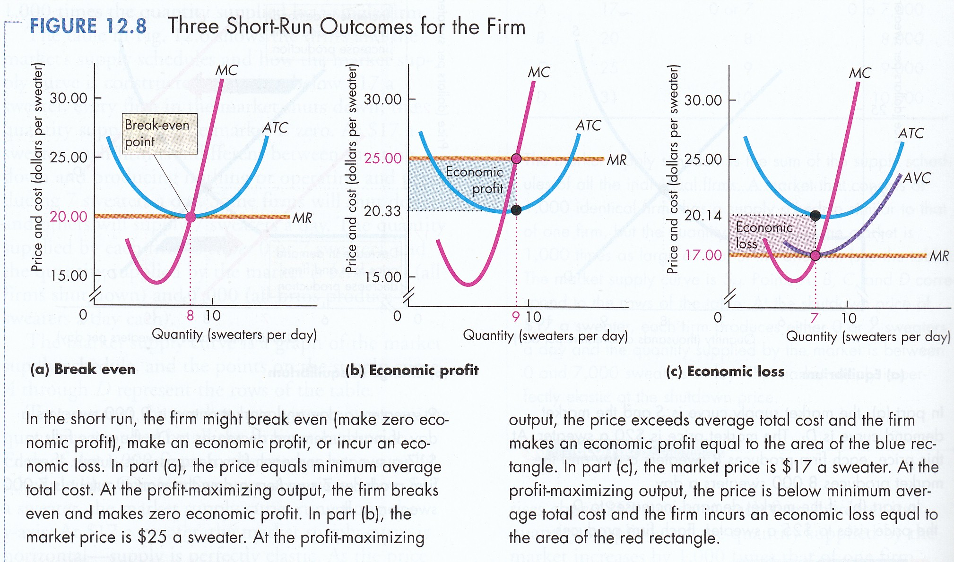

Slide 21
Predicting the future: 1989
Suppose it is 1989 and the market price of a 4-foot alligator is $180. Alligator farmers are doing great, earning significant economic profits.
http://ezproxy.uky.edu/login?url=http://search.proquest.com/docview/398158016?accountid=11836
[refer to diagrams on board].
What do you think will happen as time passes? What does it mean that firms in the industry are earning positive economic profits?
As entry occurs, what will happen to the market supply curve?
What will happen to market price?
After enough time passes for all adjustments to occur, what do you predict market price will be? How long will that take?

Slide 22
Predicting the future: 1997
Suppose it is 1997 and the market price of a 4-foot alligator is $100. Alligator farmers are struggling, suffering significant economic losses.
http://ezproxy.uky.edu/login?url=http://search.proquest.com/docview/398605851?accountid=11836
[refer to diagrams on board].
What do you think will happen as time passes? What does it mean that firms in the industry are earning negative economic profits?
As exit occurs, what will happen to the market supply curve?
What will happen to market price?
After enough time passes for all adjustments to occur, what do you predict market price will be? How long will that take?

Slide 23
Long-run equilibrium in a perfectly competitive market
A competitive market is in long-run equilibrium when:
Market price P* clears the market, i.e. market quantity demanded equals quantity supplied, i.e. Q_{D} = Q_{S} .
Each firm maximizes profit, producing $q_{i}^{∗}$ where P* = ${mc}_{i}$.
Market quantity supplied equals the aggregation of each firm’s profit maximization decision: Q_{S} = $\sum_{i=1}^{n}{q_{i}^{∗}}$
At P* firms earn a normal economic return, i.e. zero economic profit.
P* = min LRAC, i.e. firms produce the product as cheaply as is possible, given input prices and technology.

Slide 24
Working with the perfectly competitive model
Market is in long-run equilibrium. Demand increases. What happens in the short run? What happens in the long run?
Market is in long-run equilibrium. Demand decreases. What happens in the short run? What happens in the long run?
Market is in long-run equilibrium. Technology improves, such that LRAC shifts downward. What happens in the short run? What happens in the long run?
Market is in long-run equilibrium. The price of a key input increases, such that LRAC shifts upward. What happens in the short run? What happens in the long run?

Slide 25
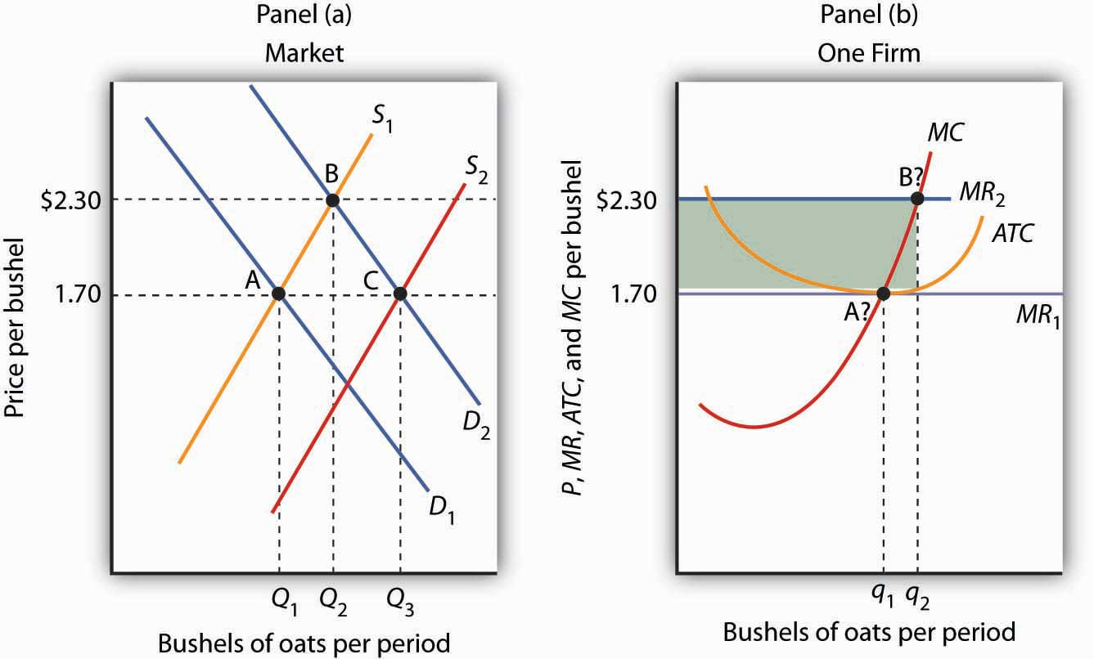

Slide 26
Choosing Output in the Long Run
Price
($ per
unit of
output)
Question: Where are long-run
profits zero?
LMC
LAC
SMC
SAC
D
A
E
$40
P = MR
C
B
G
F
$30
q₁
q₂
q₃
Output
Notes:
84

Slide 27
Long-Run Competitive Equilibrium
Profit attracts firms
Supply increases until profit = 0
$ per
unit of
output
Firm
$ per
unit of
output
Industry
S₁
LMC
$40
P₁
LAC
S₂
$30
P₂
D
q₂
Output
Q₁
Q₂
Output
Notes:
92

Slide 28
Required outside readings
“Alligator Farming Shows There’s a Lot to be Said for Cows,” WSJ, 8/2/89: your professor’s all-time favorite Wall Street Journal article!!
http://ezproxy.uky.edu/login?url=http://search.proquest.com/docview/398158016?accountid=11836
“Electric-Car Metals Let Down Investors,” WSJ, 2/19/19: what paradigm or model would you use to analyze a commodity market like cobalt or lithium?
https://search-proquest-com.ezproxy.uky.edu/docview/2183042543/fulltext/B2CCEF0846B24379PQ/76?accountid=11836
or natural gas? “Long a Promise, Gas Goes Global,” WSJ, 6/7/17. http://search.proquest.com.ezproxy.uky.edu/docview/1906346922/FFFDCE8C1817464DPQ/1?accountid=11836
“Shell Shock: Chinese Demand Reshapes U.S. Pecan Business,” WSJ, 4/18/11: another perfectly competitive market example.
http://ezproxy.uky.edu/login?url=http://search.proquest.com/docview/862237747?accountid=11836
“As Tobacco Sales Dry Up, Kentucky Farmers Look to the State’s ‘Original Crop’—Hemp,” Los Angeles Times, 2/12/19: if asked to analyze the hemp market and how it can be expected to evolve over time, what approach would you use?
https://search-proquest-com.ezproxy.uky.edu/docview/2178498475/93EE81DA0646462BPQ/4?accountid=11836

