Slide 1
ECO 610: Lecture 6
Competitors and Competition: Introduction to Market Structure

Slide 2
Competitors and Competition: Outline
Defining a market: product market and geographic market
Identifying competitors: who are your rivals?
Porter’s Five Forces model
Characteristics of market structure: sellers, buyers, product differentiation, entry conditions, information
Measuring market structure
Taxonomy of market structures:
Perfect competition
Monopolistic competition
Oligopoly
Monopoly

Slide 3
Defining a market
What is a market? Buyers, sellers, product, place.
Two dimensions to a market: product market and geographic market
Examples? Product market and geographic market scope of the following markets? UK-UL EMBA degree program; new Camry at Green’s Toyota; Tempur-Pedic gel-cooled mattress; Alltech’s Bioplex.
Key element is price sensitivity: firms competing in the same market will be sensitive to one another’s prices.
How to measure price sensitivity? Cross-price elasticity of demand

Slide 4
Identifying competitors
Who are your rivals?
Are you competing against “the market”? Examples?
Do you have identifiable rivals? Examples?
If you have identifiable rivals, how close are they?
Do you have to take into account your rivals’ possible reactions when deciding what the best course of action is for you? Examples?

Slide 5
Porter’s Five-Forces Model
Michael Porter developed a model for industry analysis that incorporates many of the concepts we have studied so far. http://www.youtube.com/watch?v=mYF2_FBCvXw
If we want to understand the nature and intensity of competition among firms in a market, we must understand the outside forces acting on firms in that industry. These forces include supplier power, buyer power, the threat of substitutes, and the threat of entry. We must also understand the market structure of the industry that inherently affects internal rivalry.
When there are only a few firms in an industry, and those firms are somewhat insulated from the other four forces, then the internal rivalry aspect of a market gets interesting.

Slide 7
Market structure
Definition: Market structure refers to those characteristics of market organization that influence firms’ behavior and performance.
What market characteristics matter most?
Number and size distribution of sellers
Number and size distribution of buyers
Extent of product differentiation
Ease or difficulty for new firms to enter the industry
Availability of information to buyers and sellers

Slide 8
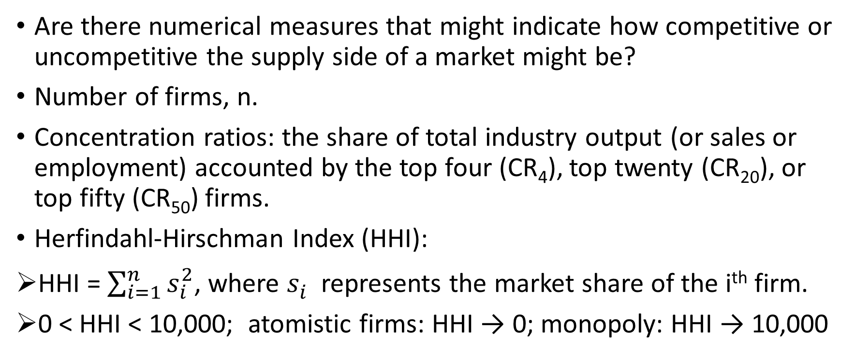
Measuring market structure
Are there numerical measures that might indicate how competitive or uncompetitive the supply side of a market might be?
Number of firms, n.
Concentration ratios: the share of total industry output (or sales or employment) accounted by the top four (CR₄), top twenty (CR₂₀), or top fifty (CR₅₀) firms.
Herfindahl-Hirschman Index (HHI):
HHI = $\sum_{i=1}^{n}{s_{i}^{2}}$, where $s_{i}^{}$represents the market share of the i^{th} firm.
0 < HHI < 10,000; atomistic firms: HHI → 0; monopoly: HHI → 10,000

Slide 9
Number and size distribution of sellers
Many sellers, each one small relative to the market
http://www.wlf.louisiana.gov/wildlife/alligator-industry-participants https://www.zomato.com/lexington-ky/downtown-restaurants
Many sellers, but one (or a few) dominant firm and many fringe producers
http://www.statista.com/statistics/216573/worldwide-market-share-of-search-engines/
Small number of sellers, each with a significant share of the market
http://www.statista.com/statistics/236309/market-share-of-global-express-industry/
https://en.wikipedia.org/wiki/Competition_between_Airbus_and_Boeing#/media/File:Lufthansa_Airbus_A380_and_Boeing_747_(16431502906).jpg
One seller of a product with no close substitutes
http://www.scientificamerican.com/article/we-now-have-the-cure-for-hepatitis-c-but-can-we-afford-it/
http://ancient-greece.org/architecture/parthenon.html

Slide 10
Number and size distribution of buyers
Many buyers, each one small relative to the market
https://foursquare.com/top-places/lexington/best-places-pizza
Small number of buyers, each with a significant market share
http://www.wsj.com/articles/aircraft-makers-narrow-engine-options-1405457174
Only one buyer
http://www.gdeb.com/

Slide 11
Extent of product differentiation
Homogeneous product: In some markets buyers consider each seller’s product to be a perfect substitute for every other seller’s product, i.e. commodity markets. Price is the only thing that matters.
Differentiated product: In many other markets, especially markets for final goods and services, sellers are able to differentiate their product from rival firms’ products in a myriad of ways. https://www.lexingtonburgerweek.com/burgers
Physical attributes
Quality
Location
Brand image
Etc.
Etc.

Slide 12
Conditions of Entry
Barriers to entry: how easy or difficult is it for new firms to enter the industry and compete with existing sellers?
Insignificant barriers to entry
https://www.entrepreneur.com/article/73384
http://myfwc.com/wildlifehabitats/managed/alligator/farming/
Significant barriers to entry
http://www.greentechmedia.com/articles/read/tesla-founder-marc-tarpenning-how-to-start-a-car-company
Blockaded entry
https://infoweb-newsbank-com.ezproxy.uky.edu/apps/news/document-view?p=AWNB&t=pubname%3ALHLB%21Lexington%2BHerald-Leader%2B%2528KY%2529/year%3A2015%212015/mody%3A0104%21January%2B04&f=advanced&action=browse&format=text&docref=news/1600A479A8C0EC20

Slide 13
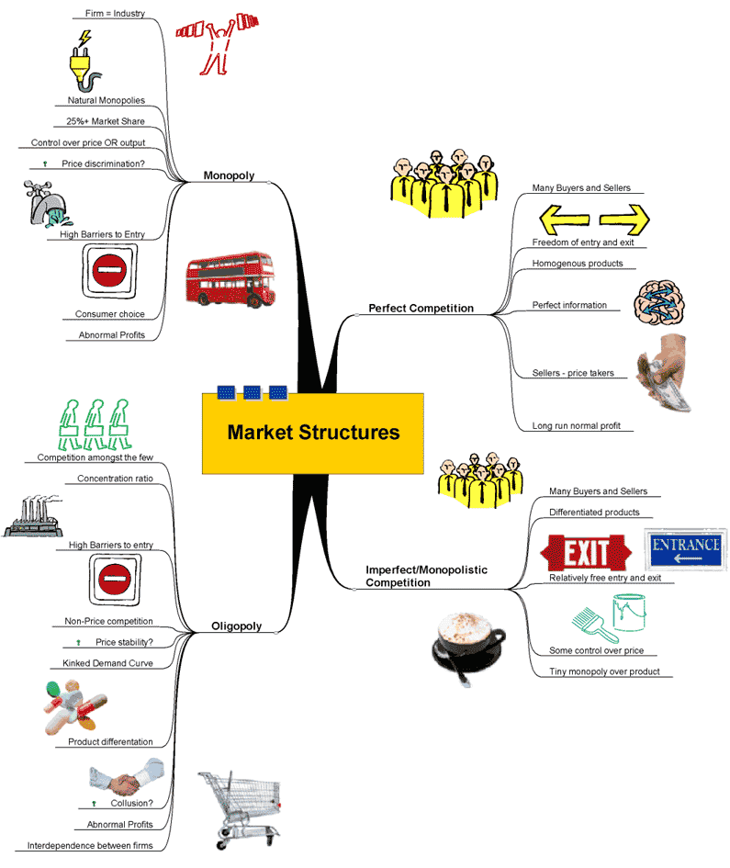
A taxonomy of market structures

Slide 14
Why study market structure?
Goal has been to understand the supply decisions of firms
Assumption (with qualifications) is that firms seek to maximize profits
Supply decision: Choose Q so as to maximize π(Q) = TR(Q) – TC(Q)
The principles we developed relating the firm’s output with its short-run and long-run costs do not depend on the type of market structure in which the firm operates.
The relationship that a firm sees between its output and its total revenue does depend on the type of market structure in which the firm competes.
Price takers vs. price searchers
So we will undertake to study firms’ supply decisions in the different types of market structures in which firms compete.

Slide 15
Required outside readings:
“’Green Gold’ Rush Eludes Greeks,” WSJ, 12/19/17: unbranded olive oil vs. branded olive oil—which market structure model is appropriate for analyzing each?
https://search-proquest-com.ezproxy.uky.edu/docview/1978204751/5057514BD29A4D70PQ/18?accountid=11836
“Restaurants Burned by Oversupply, Rivals,” WSJ, 10/17/16: what type of market structure and expected long-run profitability in the restaurant industry? http://search.proquest.com.ezproxy.uky.edu/docview/1829442259/72E60390CBF94A2EPQ/64?accountid=11836
“Boeing, Airbus Confront Crowded Skies,” WSJ, 7/17/17: can the tight duopoly market for large passenger jet airplanes last forever?
https://search-proquest-com.ezproxy.uky.edu/docview/1919400529/1A3F32BEECF54CB3PQ/57?accountid=11836
“Harry’s Cuts into Gillette’s Razor Turf,” WSJ, 11/11/16: what happens to the pricing power of a dominant firm when some upstart comes along? http://search.proquest.com.ezproxy.uky.edu/docview/1837880191/E66C037C10B4D00PQ/1?accountid=11836

