Slide 1
ECO 610: Lecture 2
Theory of Demand; Elasticity; and Marketing and Consumer Behavior

Slide 2
Theory of Demand; Elasticity; and Marketing and Consumer Behavior: Outline
Demand Theory and Marketing Research
Households’ demand for final goods and services
Firms’ demand for factors of production
Elasticity
Own-price elasticity of demand
Calculating elasticity
Own-price elasticity and total revenue
Factors affecting own-price elasticity
Income elasticity of demand
Cross-price elasticity of demand
Estimating demand relationships

Slide 3
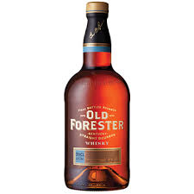
Theory of Demand/Marketing/Consumer Behavior
What is marketing? (versus advertising)
How does one do marketing research?
What theoretical framework does one use when doing marketing research?
Who are the firm’s customers? Households or firms? What decision-making process do the firm’s customers use when evaluating whether or not to purchase the firm’s product?
Examples:
Brown Forman and bourbon
Valvoline and motor oil
Alltech and animal food supplements

Slide 4
Households’ demand for final goods and services
Why do households demand final goods and services?
Because households get utility from consuming goods and services.
Quantity Demanded (Q_{D}): total amount of a commodity that all households wish to purchase.
Factors affecting Q_{D}:
tastes or preferences
income
price of the product
prices of other products
substitutes in consumption
complements in consumption
other things?

Slide 5
Firms’ demand for factors of production
Why do firms demand inputs (factors of production)?
Because firms use inputs to produce outputs that can be sold for profits.
Demand for an input is derived from the demand for the final good or service the input is used to produce.
Two key economic factors in a firm’s demand for an input:
Household demand for the final good or service
Extent to which the firm is able to substitute one input for another in its production process

Slide 6
Marketing research example
Your team is given the following assignment:
“PepsiCo Pushes Breakfast in Bid to Heat Up Oatmeal, WSJ, 7/28/10.
http://ezproxy.uky.edu/login?url=http://search.proquest.com/docview/732571063?accountid=11836
Figure out the best way to increase the demand for Quaker Oatmeal.
Where do you start?
https://www.youtube.com/watch?v=X6hE5ttzXH0
https://www.youtube.com/watch?v=vL2omjnhBNQ
https://www.youtube.com/watch?v=-Tw3AR9ubgw

Slide 7
Elasticity
Demand function: quantity demanded of good X depends consumers’ tastes or preferences, incomes, the price of good X, and the prices of other goods (like good Y, a substitute, and good Z, a complement).
Algebraically: X_{D} = d_{x}(Tastes, Incomes, P_{X} , P_{Y} , P_{Z})
We are interested in the relationship between quantity demanded of X and each of the economic factors which influence it. We have already discussed conceptually the direction of the effect of each variable that affects X_{D}
Now we want to consider the magnitude. If the price of X changes by a given amount, by how much will the quantity demanded of X change, i.e. how sensitive is quantity demanded to a change in price?

Slide 8
Three elasticities
Own price elasticity of demand: measures the sensitivity of quantity demanded of good X to a change in the price of good X
ε_{x, Px} = - (%ΔX_{D}) / (%ΔP_{x})
Income elasticity of demand: measures the sensitivity of quantity demanded to a change in income
ε_{x, Income} = (%ΔX_{D}) / (%ΔIncome)
Cross-price elasticity of demand: measures the sensitivity of quantity demanded of good X to a change in the price of good Y
ε_{x, Py} = (%ΔX_{D}) / (%ΔP_{Y})

Slide 9
Calculating Own-price Elasticity of Demand: Arc elasticity formula
ε_{x, Px} = - (%ΔX_{D}) / (%ΔP_{x})
ε_{x, Px} = - $\frac{\text{(}\text{Q}\text{1}\text{ – }\text{Q}\text{0}\text{)/}\text{[}\text{½(}\text{Q}\text{1} \text{+} \text{Q}\text{0}\text{)]}}{\text{(}\text{P}\text{1}\text{ – }\text{P}\text{0}\text{)/}\text{[}\text{½(}\text{P}\text{1} \text{+} \text{P}\text{0}\text{)]}}$
ε_{x, Px} = - $\frac{\text{Δ}\text{Q}\text{/(}\text{Q}\text{1}\text{ + }\text{Q}\text{0}\text{)}}{\text{Δ}\text{P}\text{/(}\text{P}\text{1}\text{ + }\text{P}\text{0}\text{)}}$

Slide 10
Calculating Price Elasticity of Demand for Tennis Lessons
Price per Lesson
($/hr)
A
100
B
80
C
40
D
20
D
5
10
15
20
25
30
Q (# of Students per week)

Slide 11
Examples calculating arc elasticity
Calculating ε_{x, Px} from
point A to point B:
P₀=100, P₁=80, Q₀=5, Q₁=10
Calculating ε_{x, Px} from
point C to point D: ε_{x, Px} = - $\frac{\text{(}\text{3}\text{0 – }\text{2}\text{5)/[½(}\text{3}\text{0 + }\text{2}\text{5)]}}{\text{(}\text{2}\text{0 – }\text{4}\text{0)/[½(}\text{2}\text{0 + }\text{4}\text{0)]}}=\frac{\text{5}\text{/}\text{5}\text{5}}{\text{20/}\text{6}\text{0}}=3/11$
P₀=40, P₁=20, Q₀=25, Q₁=30
ε_{x, Px} = - $\frac{\text{(}\text{10}\text{ – }\text{5}\text{)/[½(}\text{10}\text{ + }\text{5}\text{)]}}{\text{(}\text{80}\text{ – }\text{100}\text{)/[½(}\text{80}\text{ + }\text{100}\text{)]}}=\frac{\text{5}\text{/}\text{15}}{\text{20}\text{/}\text{180}}=3$

Slide 12
How to interpret the elasticity coefficient:
if ε_{x, Px} > 1 then we say that demand is elastic:
%ΔQ > 1
%ΔP
or %ΔQ > %ΔP. This occurs when consumers are relatively responsive to a change
in the price of good X.
if ε_{x, Px} < 1 then we say that demand is inelastic:
%ΔQ < 1
%ΔP
or %ΔQ < %ΔP. This occurs when consumers are relatively unresponsive to a change
in the price of good X.
if ε_{x, Px} = 1 then we say that demand is unitary elastic:
%ΔQ = 1
%ΔP
or %ΔQ = %ΔP.

Slide 13
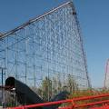
Own-price elasticity and total revenue
“Thrill parks try to boost attendance: Some lower their fees to attract crowds,” Lexington Herald-Leader, 5/27/06. http://bit.ly/odthLq
https://www.cedarpoint.com/play/rides-coasters
Case study: you own and operate an amusement park. Your costs are primarily fixed—once you decide on a schedule your costs do not vary much with the number of patrons in the park.
Challenge is to maximize total revenues, in so doing you will maximize profits.
If you want to increase total revenues, should you raise price or lower the price of admission?

Slide 14
Suppose you raise price by 5% and the number of customers falls by 10% in response. What is own-price elasticity of demand? Does total revenue go up or down?
Suppose you lower price by 5% and the number of customers increases by 10% in response. What is own-price elasticity of demand? Does total revenue go up or down?
Suppose you raise price by 10% and the number of customers falls by 5% in response. What is own-price elasticity of demand? Does total revenue go up or down?
Suppose you lower price by 10% and the number of customers increases by 5% in response. What is own-price elasticity of demand? Does total revenue go up or down?

Slide 15
General principles:
If ε_{x, Px} > 1, i.e. demand is elastic, then (%ΔX_{D}) > (%ΔP_{x}) . An increase in price will cause total revenue to fall and a decrease in price will cause total revenue to rise.
If ε_{x, Px} < 1, i.e. demand is inelastic, then (%ΔX_{D}) < (%ΔP_{x}) . An increase in price will cause total revenue to rise and a decrease in price will cause total revenue to fall.
If ε_{x, Px} = 1, i.e. demand is unitary elastic, then (%ΔX_{D}) = (%ΔP_{x}) . Total revenue will stay the same after either a price increase or price decrease.

Slide 16
Determinants of Price Elasticity
Are there economic characteristics of the product that might help us predict whether demand will be elastic or inelastic? Under what conditions will consumers be sensitive or insensitive to a change in price?
Availability of substitutes: if there are many good close substitutes for a product and its price increases, then consumers will . . .
Definition of the product: the more narrowly defined is the product, the more good close substitutes there are . . .
Share of the budget: the greater the share of their budget consumers spend on an item, the . . . sensitive they will be to a price change.
Time to adjust: the more time that consumers have to adjust to a price change, the . . . sensitive they will be to a price change.

Slide 17
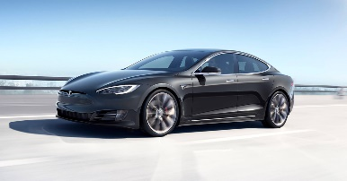
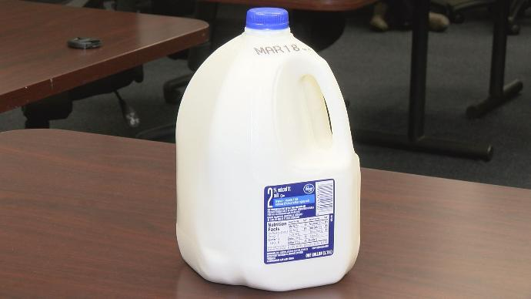
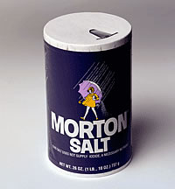
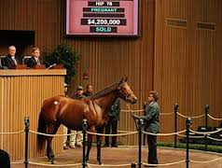
Examples using own-price elasticity
Residential demand for electricity—availability of substitutes.
Lighting? Space heating?
Forecasting motor oil demand for Valvoline:
short run vs. long run?
Supermarket advertising and loss leaders—milk or salt?
How to set excise taxes if the goal is to raise revenue—excise tax on cigarettes? Sales tax on thoroughbreds at Keeneland?

Slide 18
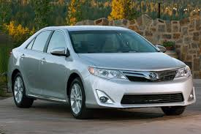
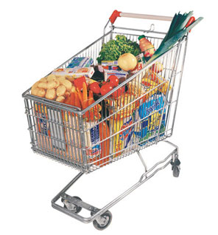
Income Elasticity of Demand
ε_{x, Income} = (%ΔX_{D}) / (%ΔIncome) = [ΔQ / (Q₀ + Q₁)] / [ΔI / (I₀ + I₁)]
ε_{x, Income} > 0 , quantity demanded increases when income increases and
vice versa. We call these Normal Goods.
ε_{x, Income} < 0 , quantity demanded decreases when income increases and vice versa. We call these Inferior Goods.
Among normal goods, if 0 < ε_{x, Inc} < 1 , i.e. consumption of a good increases when income increases, but less than proportionate to the increase in income, we call this type of a good a Necessity.
Among normal goods, if ε_{x, Inc} > 1 , i.e. consumption of a good increases when income increases, but more than proportionate to the increase in income, we call this type of a good a Luxury Good.

Slide 19
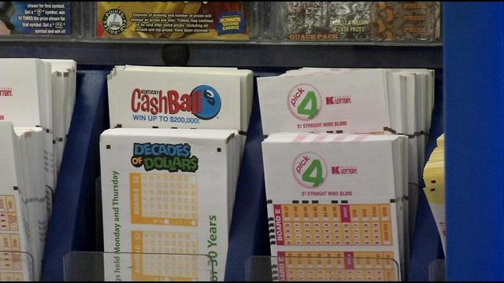
Examples using Income Elasticity of Demand
Kentucky Lottery Commission: what are your products? Who are your customers, i.e. what is the income elasticity of demand for the different products you sell? How would you market the different products?
Instant scratch-off games?
Daily numbers games?
Lotto games: e.g. Pick Six, Powerball?
How would you go about estimating income elasticity of demand for different lottery products?

Slide 20
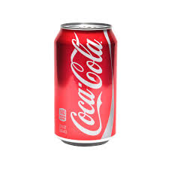
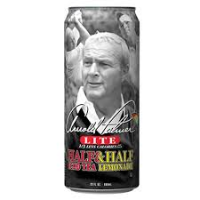
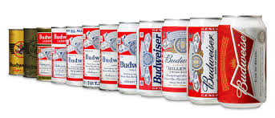
Cross-price Elasticity of Demand
ε_{x, Py} = (%ΔX_{D}) / (%ΔP_{Y}) = [ΔQ / (Q₀ + Q₁)] / [ΔP_{Y} / (P_{Y0} + P_{Y1})]
ε_{x, Py} > 0 when an increase in the price of good Y leads to an increase in the demand for good X and vice versa. Goods X and Y are Substitutes.
ε_{x, Py} < 0 when an increase in the price of good Y leads to an decrease in the demand for good X and vice versa. Goods X and Y are Complements.
How do we interpret the magnitude of the cross-price elasticity? i.e. what is the cross-price elasticity between Coke and Pepsi? Coke and Snapple iced tea? Coke and Dean’s chocolate milk? Coke and Bud Lite?

Slide 21
Marketing Research—Estimating Demand
Suppose we want to quantify the relationship between quantity demanded of a product and various economic factors that affect it.
There are various ways to collect empirical data on demand:
Consumer interviews and surveys
Controlled market studies
Uncontrolled market data
Examples:
Frito-Lay comes up with new low-calorie potato chip and wants to know what price point to introduce it at. $500,000 research budget.
Can Lexington support a minor-league baseball team? $50,000 budget.

Slide 22
Required Outside readings:
“PepsiCo Pushes Breakfast in Bid to Heat Up Oatmeal,” WSJ, 7/28/10: imagine that you are named brand manager for this newly acquired product line and are tasked with pumping up demand for Quaker Oats.
http://ezproxy.uky.edu/login?url=http://search.proquest.com/docview/732571063?accountid=11836
“Thrill parks try to boost attendance: Some lower their fees to attract crowds,” Lexington Herald-Leader, 5/27/06: to increase our revenues, should we raise or lower the price of admission? http://bit.ly/odthLq
“For Dollar Stores, a Mixed Bag,” WSJ, 7/11/13: do all companies suffer in a recession? http://ezproxy.uky.edu/login?url=http://search.proquest.com/docview/1399253185/13FBAC776B7259CDD87/82?accountid=11836
“The Millennial vs. Boomer Stock Smackdown,” WSJ 6/7/19: trying to decide what stocks to include in your personal retirement account?—how tastes/preferences differ across socio-economic groups and how that affects profitability.
https://search-proquest-com.ezproxy.uky.edu/docview/2236060595/4368C0827FFF4982PQ/81?accountid=11836

